Slide 1


Nice July 9th
2014
Environmental Innovations: markets, policy and evolutions

Slide 2
Eco Innovations (EI)
Theory of externality
sustainability
Drivers of EI
Effects of EI
  Economic perf
  Environmental perf

Slide 3
Optimality conundrum
Externality

Slide 4
Externality or sustainability economics? Ecological Economics 2010, JCJM van den Bergh
Are externalities a neoclassic concept or a fact of socio economic life?
«the notion of externality merely conveys the idea that human interactions or interdependencies extend beyond formal markets characterised by prices and exchanges. (..) the notion of externality reflects the adoption of a system perspective by a researcher»

Slide 5
(Arthur Cecil Pigou, 1920)
p
C^{I}_{S}
B
C^{I}_{P} ≡ SS₀
E^{I}
p^{B}
t
DD
q^{B}
q

Slide 6
Efficiency without optimality: the charges and standard approach
«The charges or prices would be selected so as to achieve specific acceptability standards rather than attempting to base them on the unknown value of marginal net damages»
«In marked contrast to an attempt of optimisation, should iterative adjustments in tax rates prove desirable in a charges and standard approach… They require no data on costs and damage, only figures on current pollution»
«least cost method for the achievement of these targets»

Slide 7
CH 11 Baumol & Oates – A theory of environmental policy
The validity of the least cost theorem does not require profit maximizer or perfect competition, all that is necessary is that firms minimise cosst or whatever ouput they select
  Invariance wrt market structure
The approach approximate a pigovian outcome
New and broad policy optimality definition: efficiency, effectiveness, social feasibility (broadly defined)
  www.cecilia2050.eu
It leads to Political economy issues

Slide 8
Pearce DW (2005), Energy Economics: The Political economy of an energy tax
Textbook recommendations dont consider the political context (different social welfare functions)
However, great care is needed
  «explaining differences between optimal and actual design of policy measures does not justify them. Normative political economy then has the role of asking whether the various institutional and political constraints really are as limiting as the political economy model might suggest»
  «what is becomes what should be» « This Panglossian analysis needs to be avoided»

Slide 9
Environmental Policy

Slide 10
Economic instruments
Taxation
Emission trading
  EU ETS Policy (Directive 2003)
  Pigou + Coase
Liability schemes
Subsidy
  Tax + lump sum

Slide 11
Static Pigovian efficiency
Dynamic efficiency → innovation effort (Kemp, 1997)
  Links to Porter idea of Competitive advantages

Slide 12
Introduction
EU 2030 targets for climate change: 40% cut in CO₂ emissions with respect to 1990.
  EU 2050 targets: 90% cut with respect to 1990
Impact mostly on industrial sector and transport
  2020 targets will be reached only without a revival of economic growth
  Not taking into account the (non binding) EU strategy to re-manufacture Europe

Slide 13
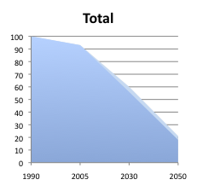
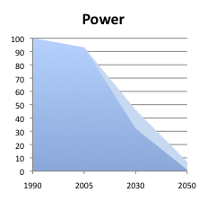
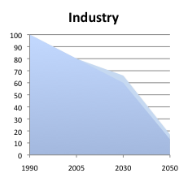
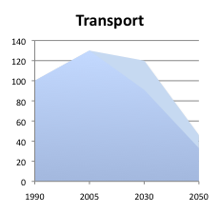
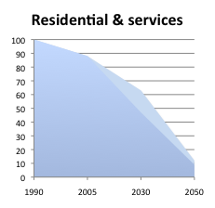
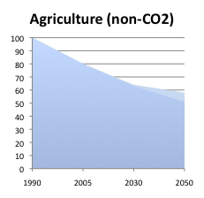
Starting Point: low-carbon economy requires a radical transformation…
- 78-82%
- 93-99%
83-87%
- 42-49%
- 54-67%
- 88-91%
Source: Roadmap Impact Assessment SEC(2011) 288

Slide 14
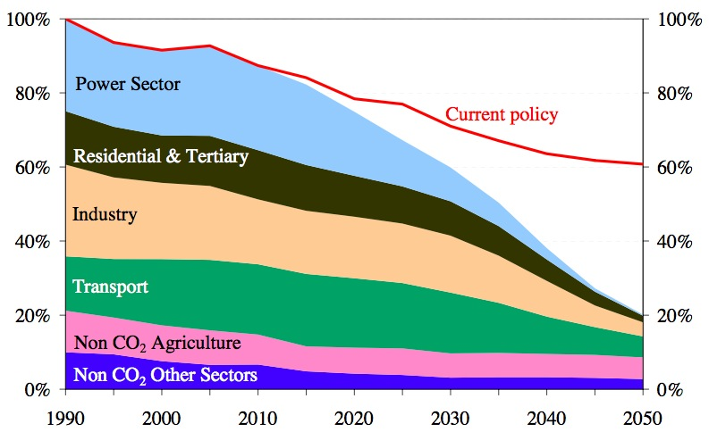
… but current policies are not equipped to deliver this transformation
Source: “A Roadmap for moving to a competitive low carbon economy in 2050” COM(2011)112

Slide 15
Sustainability – two ideas of

Slide 16
Sustainable society is an ‘investing society’
Sustainability I: Capital based economic view

Slide 17
Kt+1 – Kt = Inv - αK =ΔK
Y = f(K+) = K^{1/2}
Y = f(Khuman, Kmanmade, Kenv, Kcult…)
Simple macroeconomics
  Y = C + I
  Y_{t} – C_{t} = Saving_{t} = I _{t} = ΔK
  At least may mean Yt+1 ≥ Yt (sust rule)

Slide 18
Capital shares at different income levels

Slide 19
Applied estimations genuine saving
(world bank)
Kazakistan
  30% GDp gross saving
  18% net saving
  Saving Rises to 22% including education investments
  - 10% including all natural resource depreciations
    Negative genuine saving

Slide 20
Holland vs Kenya capital stocks shares of wealth
Holland
  78% Human capital + institutions
    Of which 36% schooling; 57% institutions, property rights
  3% natural capital (of which 57% land)
  19% produced man made capital
Kenya
  46% natural capital (1/2 crops)
  13% man made
  42% intangible including human capital

Slide 21
Hamilton adjusted rule (2007)
ΔU/ Δt= Uc G(r- ΔG/G)
  G= genuine saving (net saving)
G=0 Hartwick rule → ΔU/ Δt=0
G=Y/G fixed share
Growth in net income
  Δ(C+G)/(C+G) = net saving (constant)* MPK (r)/α
  MPK 0.07 o 7%
  α = non nat resource share, around 0.7 average
  So Δ(C+G)/(C+G) = net saving (constant)* 0.1
    Growth 10% of net saving

Slide 22
Ferreira Hamilton Vincent (2008)
Current saving → future consumption
  Gross -0.76*
  Net save -0.72*
  Green saving 0.558**
  Pop adjusted 0.560**
Ferreira Vincent add developing countries

Slide 23
Holland vs Kenya capital stocks shares of wealth
Holland
  78% Human capital + institutions
    Of which 36% schooling; 57% institutions, property rights
  3% natural capital (of which 57% land)
  19% produced man made capital
Kenya
  46% natural capital (1/2 crops)
  13% man made
  42% intangible including human capital

Slide 24
Ghana – decomposition of genuine saving
SD → What matters is to accumulate an increasing stock of total capital forms

Slide 25
Key issues
Sustainable development
  Weak and strong economic perspectives
  Daly idea of zero growth
  Renewable and non renewable resources
Environmental efficiency of economic systems
  The critical role of innovation→ only engine for sustainaed economic growth and sustainability (Solow models)
  Sustanaibility and sustaianed growth entangled issues: trade offs but also complementarities through the role of innovation

Slide 26
What is sustainable development?
SD is the achievement of a sustained path of economic growth which does not undermine future generation possibilities of consumption
We may define what “future generation” means
  An orthodox economist would claim that this depends on our time preference → discount rate reasoning..
  The higher the discount rate, depending on consumption and oportunity costs factors, the less future benefits and costs are valued…
  r = pure time myopic preference + consumption growth; otherwise equals tha market oppotunity cost, the foregone benefit of an investment

Slide 27
Recall that GNP=C+I
Recall that NetNP= GNP – depreciation of capital
Capital stocks dynamics depends on accumulation and depreciation

Slide 28
SD is linked to Total capital or natural capital?
Total capital = manmade + human capital + natural capital
Each capital stock is defined by a rate of growth, I – Deprec.
If I=dep, then capital is steady
Y=(TOT-K)
Thus, a first intuitive golden rule for SD is that total K should be at least constant, Inv should at least match depreciation..
Genuine saving rule: INV >= depreciation

Slide 29
..but..
This may imply a decreasing natural capital stock, if natK is substituted by other forms
  This is the western country history
  i.e. arab countries management of non renewable resources
  UK oil exploitation
  In any case, rents from natural resource use should be re-invested..

Slide 30
Thus, weak sustainability may also imply a complete exhaustion of natural resources…
Strong sustainability is instead stressing the critical role of some natural capital forms…irreversible losses…eco-systemic losses
The genuine saving rule is applied to specific environmental assets
  i.e. compensation projects
  It works for renewable resources (forests, fishery..)
  Striking difference between the management of non renew resources (the problem is a correct price and a path of exploitation which takes into account the existence of an alternative backsyop technology) and renewable resources, which often posses use and non use values…

Slide 31
SD is also possible in case a reduced amount of capital is inherited by future generations….
…but this capital must be more productive..more efficient..
We go back to the role of environmental innovation in triggering higher resource efficiency of the economy
A key issue is what he driving forces of innovation are:
  Prices (neoclassic view)
  Policy → which kind of policy…static reasoning demonstrate the higher efficiency of green taxes and tradable permits (over CAC)…dynamic efficiency should also be higher for economic instruments, but it is more an empirical matter
  Firm internal strategies..Porter hp..firm gains from innovation in the long run, to achieve new competitive advantages…hp at macro and micro level
  A weak version of the hp claims that in the long run the policy costs are lower than the induced innovation gains…NET benefits..

Slide 32
..summing up..
SD depends on the decision on how much investing in each period…(recall Y=C+I)..a part of the investment is in innovation (tech and organizational)
..but even sustained economic growth (Solow Model) is possible only in presence of technological change enhancing factor productivity..
SD intrinsically depends on innovation, which is an investment, which also depends on economic growth..
The possibility of achieving a SD path relies on the extent to which innovation investments are capable of reducing the impact of a sustained economic growth..
This issue is known as Delinking: environmental impact from economic growth

Slide 33
Sustainable society is a society that ‘de-couples’ environmental performance from growth
Sustainability II: efficient growth

Slide 34
CO2/GDP intensity - 42% over 1950-2000
  GDP per capita: three times higher over1950-2000

Slide 35
High growth
ITALY

Slide 36
EU south
Notes:
36

Slide 37
North America and Oceania
Notes:
37

Slide 38
EU North
Notes:
38

Slide 39
Scenarios: MSW generation and landfilling in the EU-27
Note: Figures from 1980-2004 are data from Eurostat.
Figures from 2005-2020 are projections. BMW = biodegradable municipal waste.
Source: EEA (2007).

Slide 40
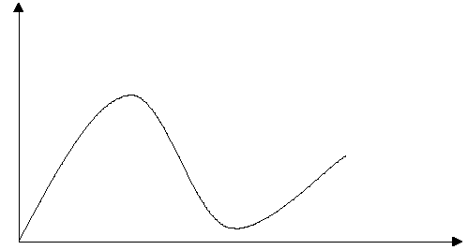
Delinking and Kuznets curves
Turning point
Policy effect?
Environmental pressure
Absolute delinking
Recoupling possibility (?)
Relative delinking
(if any)
Economic drivers

Slide 41
EKC and IPAT
IPAT Identity
  I=P*A*T
  I=P*A/P*I/T
  Stochastic IPAT can be estimated as
    Emissions = f(POP, GDP per capita, Tech, etc…)
! Different from the estimation of
  Environmental productivity
    Emissions on GDP
    Emissions per capita

Slide 42
Delinking
Advanced economic systems have been characterised by a decreasing intensity of energy and materials per unit of output, driven by technological dynamics and regulatory pressures.

Slide 43
Delinking may occur on a relative basis (the elasticity of the environmental impact indicator with respect to an economic driver is positive, but less than unity) or on an absolute basis (negative elasticity).
The assessment of both de-linking processes can be referred to the mostly applied research field concerning Environmental Kuznets Curves (EKC).
The hypothesis derives from the original analysis of Kuznets on the relationship between income level and income distribution

Slide 44
The EKC hypothesis is shortly that for many environmental impacts, an inverted U-shaped relationships between per capita income and pollution is documented.
The concentration of a certain pollutant first increases with income/production, reflecting a scale effect, more or less proportional, then eventually starts to decrease, de-linking from income even on an absolute basis.
More specifically, the hypothesis predicts that the “environmental income elasticity” decreases monotonically with income, and that it eventually changes its sign from positive to negative, thus defining a turning point for the inverted U-shaped relationship.
It does not derive from a theoretical model, it is an intuitive conceptual approach, inductive in nature..though some theoretical explanations have emerged…

Slide 45
EKC motivations
Supply side
  Technology driven by economic growth (profits and investments..)
  The share of cleaner activities in GDP increases with the scale of the economy (scale + composition effects)
  As scarcity increases, market prices should reflect it..self-regulatory mechanism?
  Environmental policy more likely in a developed economy → economic and political conditions needed
  Property right enforcement (policy issue)
Demand side
  Environmental quality is a normal luxury good (as culture)..higher incomes mean higher WTP for the environmental services..higher taxes are possible, new markets are profitable..
  Preferences change as the society develops..the marginal value of consumption is positive but decreasing
  Environmental costs are increasing even steeply…growth benefits decreasing….even a simple marginal cost-benefit scheme may explain why delinking may occur
As it is evident, many forces play their role, in the interplay between supply and demand, and between policy and spontaneous market dynamics

Slide 46
Eco innovations and inventions

Slide 47
Environmental Innovations
(unintended?) Induced effects of ETR: Porter and beyond…

Slide 48
MEI (Measuring Eco-Innovation) research project eco-innovation is defined as
“the production, assimilation or exploitation of a product, production process, service or management or business method that is novel to the organisation (developing or adopting it) and which results, throughout its life-cycle, in a reduction of environmental risks, pollution and other negative impacts of resources use (including energy use) compared to relevant alternatives”.

Slide 49
Categories of eco-innovation
A. Environmental technologies
  Pollution control technologies including waste water treatment technologies
  Cleaning technologies that treat pollution released into the environment
  Cleaner process technologies: new manufacturing processes that are less polluting and/or more resource efficient than relevant alternatives
  Waste management equipment
  Environmental monitoring and instrumentation
  Green energy technologies
  Water supply
  Noise and vibration control
B. Green energy technologies
C. Organizational innovation for the environment:
  Pollution prevention schemes
  Environmental management and auditing systems
  Chain management: cooperation between companies so as to close material loops and to avoid environmental damage across the value chain (from cradle to grave)
D. Product and service innovation offering environmental benefits:
  New or environmentally improved products (goods) including eco-houses and buildings
  Green financial products (such as eco-lease or climate mortgages)
  Environmental services
  Services that are less pollution and resource intensive (car sharing is an example)
E. Green system innovations
F. General puropose technologies offering green benefits

Slide 50
Eco-innovation effects
Less pollution
Less pollution and waste management costs
Less resource costs
Increased sales
Quality of life benefits

Slide 51
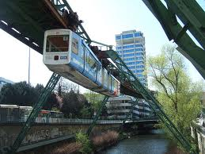

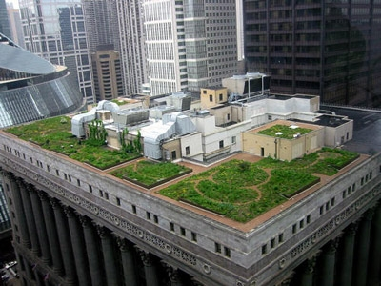
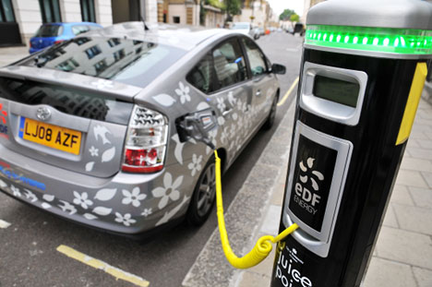
Eco-innovation for a better Quality of Life

Slide 52

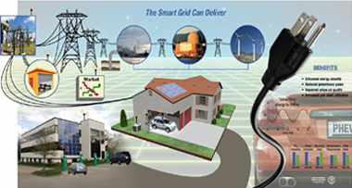
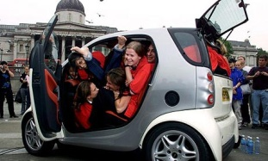

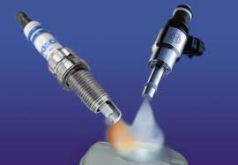
A typology of innovation
Source: Kemp (2012) based onAbernathy and Clark (1985)

Slide 53
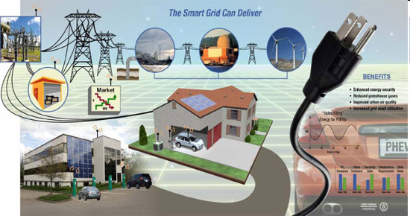
Smart grids + plug-in EV

Slide 54

Possemarré (Germany)
Passive homes with heat exchange system (100 m deep)
New destination of old factory
Located near public transport hubs to Dusseldorf and Wuppertal
Urban element in green environment (Neadertal)
Different age groups
Working and living
KFW loans for eco-houses

Slide 55
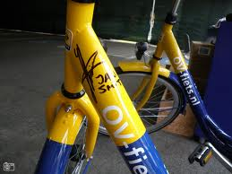


Bike – train integration (NL)
Public bikes at railway stations (OV-fiets)
3€ per day, 10 € subscription
Bikes serviced and stalled in special racks
1 million trips in 2011, large share of business trips
Development opportunities
  Electric bikes, scooters
  Public bikes at P+R sites
  From an alternative to public transport
  to an alternative to cars
  Smart phone bicycle route navigation

Slide 56
Why should we eco innovate?
Policy and regulations
  Command and control
  Economic instruments
Abate energy costs
  ‘paradox of Monopoly power’ – Italian energy efficiency
  Also Energy vs carbon taxation
CSR – go beyond policies
Create value and markets
  Product innovations

Slide 57
Two externalities
Environmental externalities
Knowledge externalities
Also mixed public goods
  R&D and emission abatement
  Corradini M. Costantini V. Mancinelli S. Mazzanti M. 2014, Unveiling the dynamic relation between R&D and emission abatement. National and sectoral innovation perspectives from the EU, Ecological Economics, forth.

Slide 58
Green Inventions

Slide 59
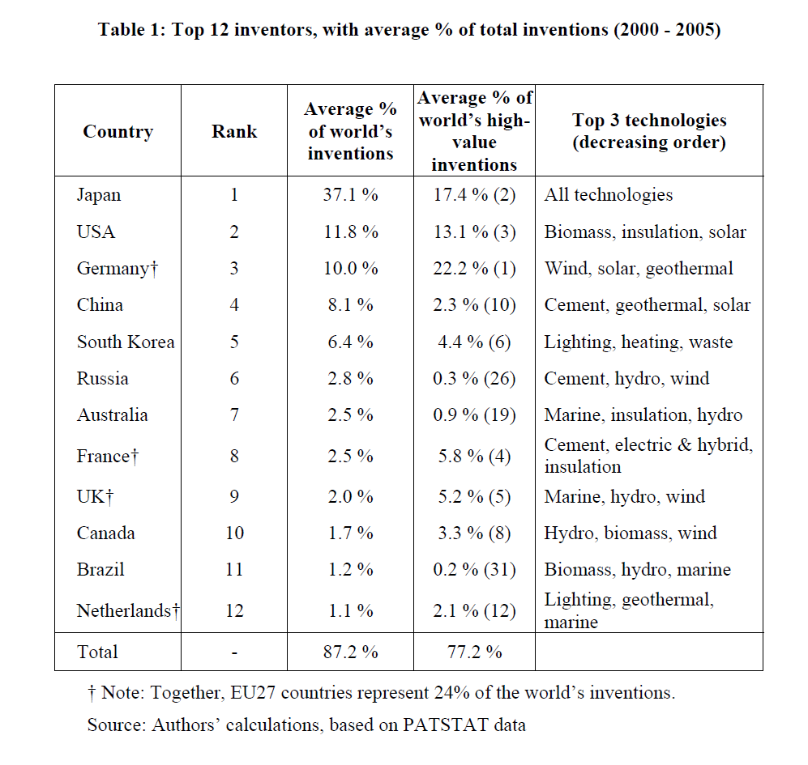

Slide 60
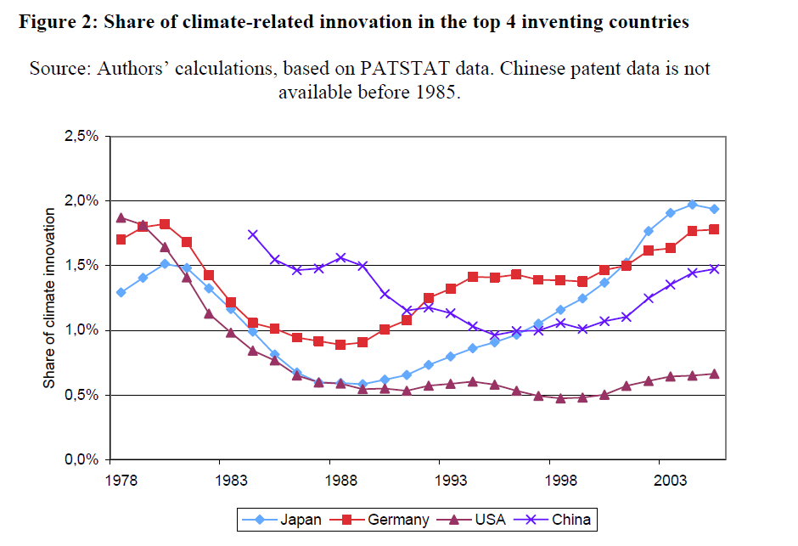

Slide 61
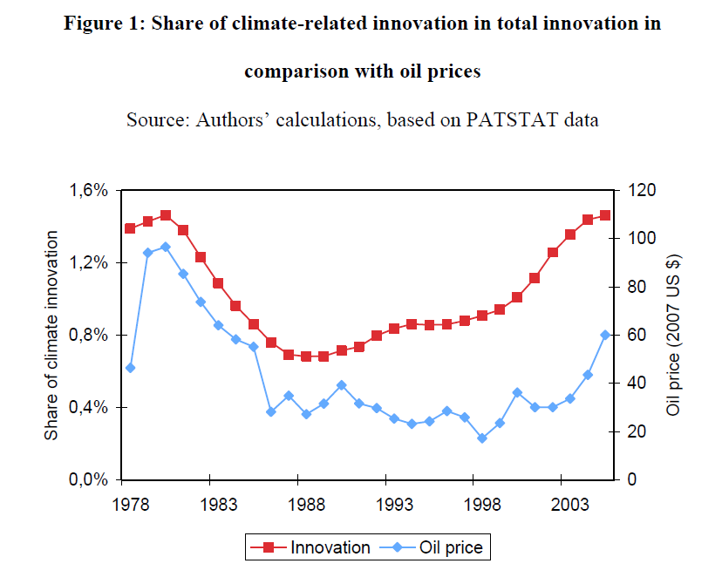
Kyoto?

Slide 62
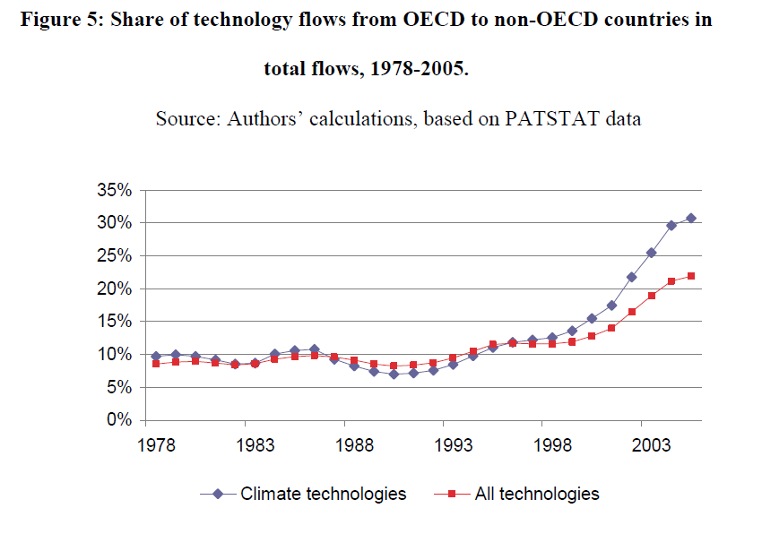
Glachant et al (2011), Review of environmental economics and policy

Slide 63
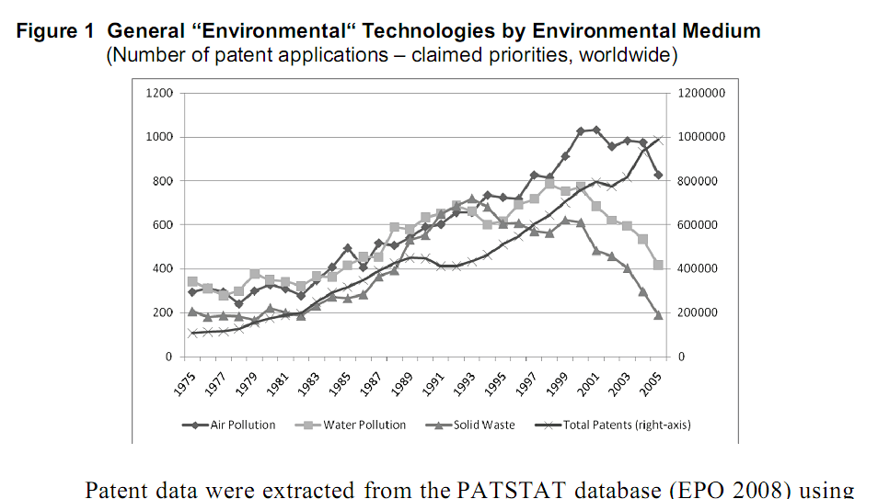
Grafico waste da oecd

Slide 64
Waste patents, Recycling and municipal Solid Waste. Three years moving average, solid waste on the right axis
EU Landfill Directive
DE pack Law
US Recovery Act
EU Pack beverage Directive
EU Pack waste Dir

Slide 65
Johnstone, N. Hascic I., Popp D., (2010), Renewable energy policies and technological innovation: Evidence based on patent counts, Environmental & Resource economics, Vol. 45, pp. 133-155.
Popp, D., (2006), International innovation and diffusion of air pollution control technologies: the effects of NOX and SO2 regulation in the US, Japan, and Germany, Journal of Environmental Economics and Management, Vol. 51 (1), pp. 46-71.

Slide 66
EI adoption and diffusion

Slide 67
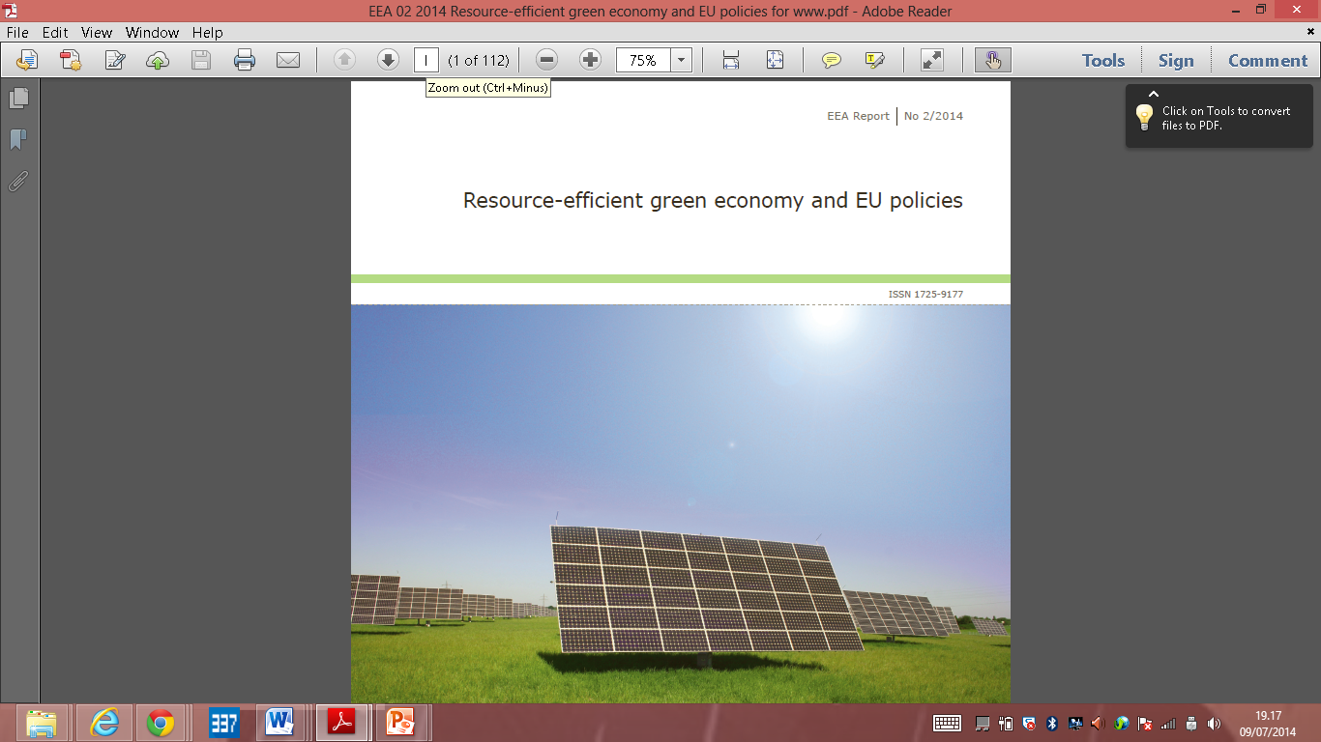

Slide 68
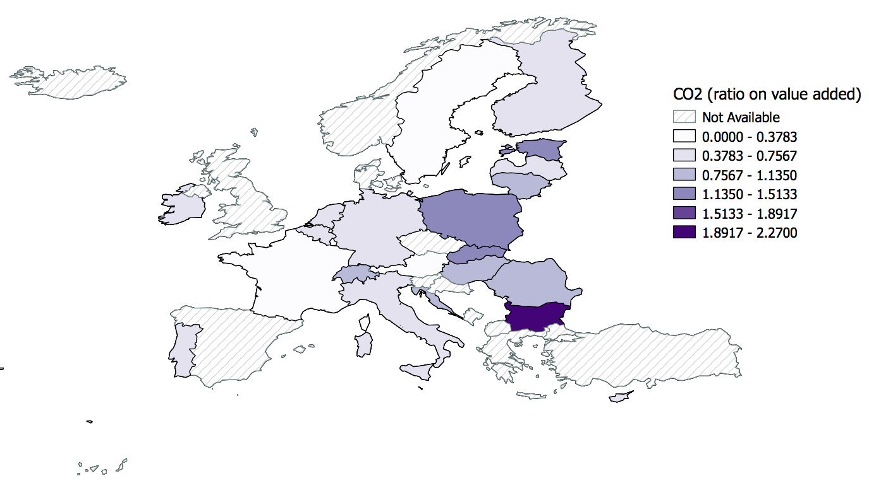

Slide 69
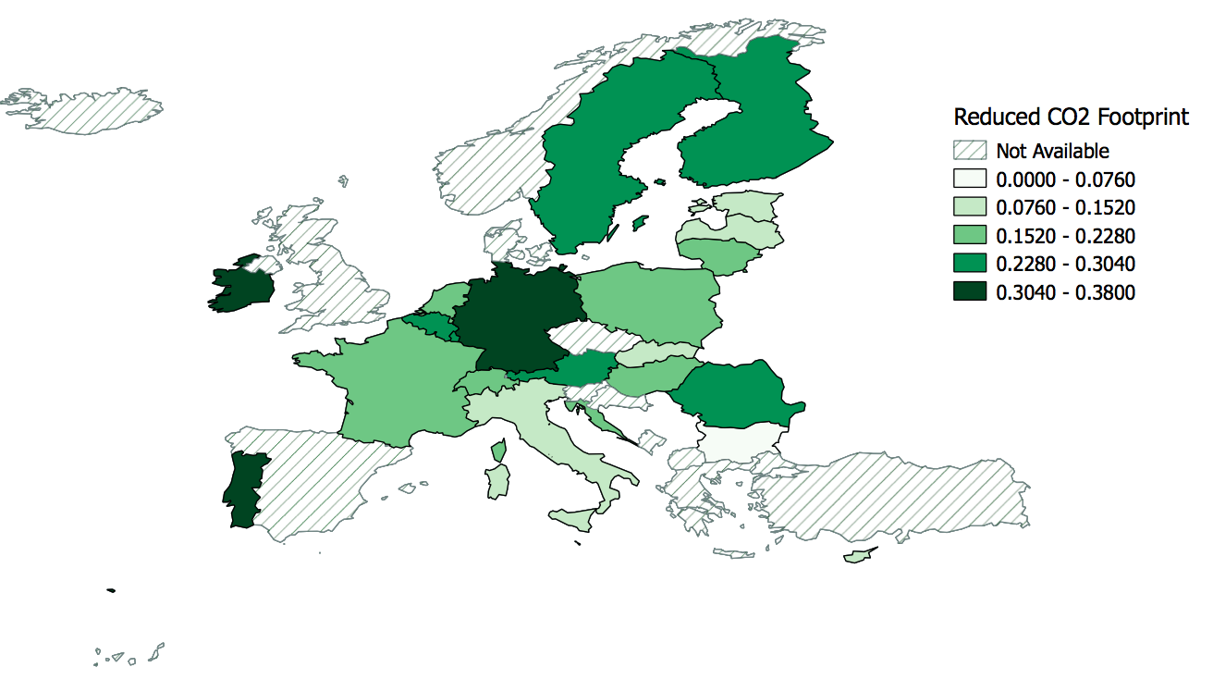
CO2 abatement innovation

Slide 70
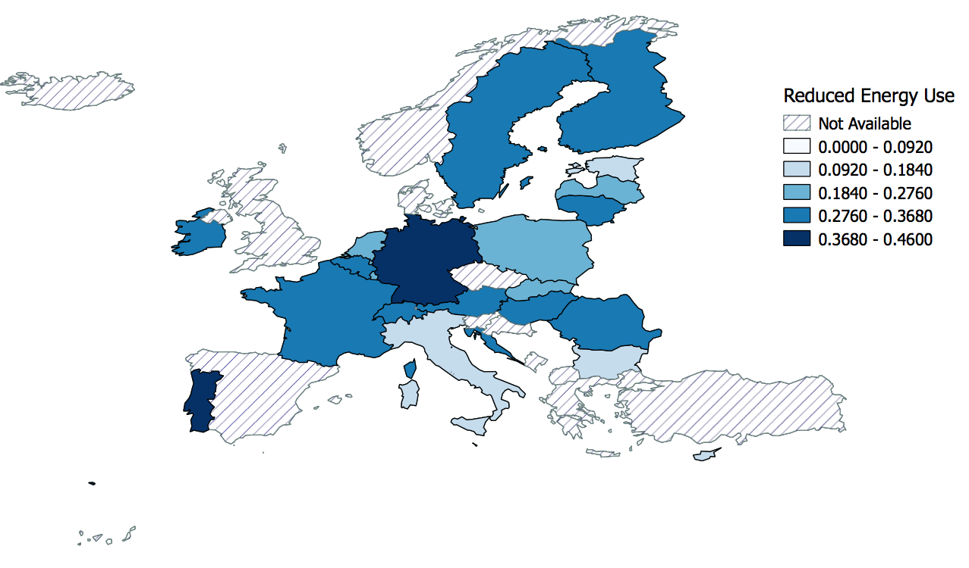
Energy efficiency abatement innovation

Slide 71
Environmental productivity and innovation

Slide 72
Environmental productivity and innovation
Not easy causal definition

Slide 73
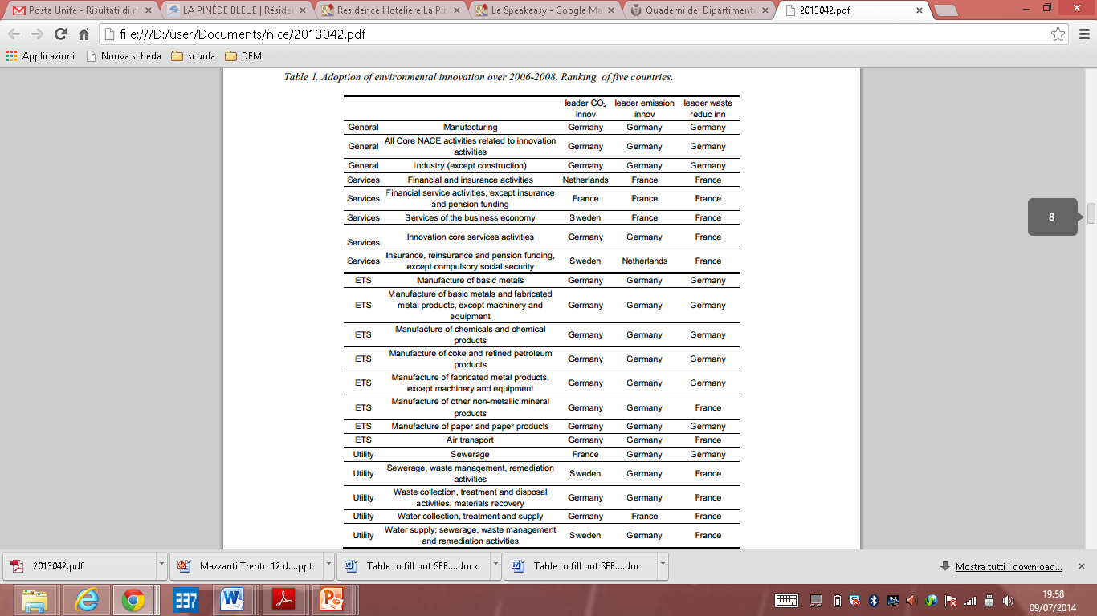

Slide 74
Drivers of EI
Effects of EI
Complementarity (among drivers and innovations as well)
Regional aspects

Slide 75
Env productivity (hybrid)
Environmental performances
Economic performances
Eco innovations
Tech-org innovations
Environmental /innovation policy
Agglomeration economies (eco inno) / spatial factors
Closed loop performances → R&D + policy → Innovation → performances

Slide 76
Useful Theory (main)
Porter hypotheses
  1. Well designed policies create innovation offsets
  2. well designed policies
Complementarity theory
  Among policies, among innovation drivers
Pollution haven / FDI – MNC – International dimensions
  Env policy might induce production reallocation
    If all externalities are taken into account bilaterally this is not an issue from a conceptual point of view
  MNC may transmit policy and market knowledge to local firms and SME’s (global and local factors interact)
    Cainelli, Mazzanti and Montresor (2012), I&Innovation
    Cainelli, Mazzanti and Montresor (2014), forth.

Slide 77
Some recent papers
Cainelli G. Mazzanti M. 2013, Environmental Innovations in services, Research Policy, November.
Horbach, J., Rammer, C., Rennings, K. (2012), Determinants of eco-innovations by type of environmental impact—The role of regulatory push/pull, technology push and market pull. Ecological Economics, 78: 112-122.
Horbach, J., (2008). Determinants of Environmental Innovations, New Evidence From German Panel Data Sources. Research Policy 37, 163-73.
Kemp, R., (2010). Eco-innovation: Definition, Measurement and Open Research Issues. Economia Politica 3, 397-420.
Kemp, R., and S. Pontoglio (2011) The innovation effects of environmental policy instruments—A typical case of the blind men and the elephant?, Ecological Economics, 72: 28-36

Slide 78
Porter hp recent papers (some)
Mohnen, P. Van Leeuwen, G. (2013) Revisiting the porter hypothesis: An empirical analysis of green innovation for the Netherlands, UNU-MERIT Working Paper Series 002, United Nations University, Maastricht Economic and social Research and training centre on Innovation and Technology.
Ambec et al. 2014, Review of environmental economics and Policy (REEP), Porter +20 paper
Costantini V. Mazzanti M. 2012, On the green side of trade competitiveness? Research Policy, February, vol.41.
Tubb and Cohen, 2014, meta analysis, presented at Wcere Itsanbul.

Slide 79
Complementarity theory
Gilli M. Mancinelli S. Mazzanti M., 2014, Innovation complementarity and environmental performances: reality or delusion? Evidence from the EU, Ecological Economics
  With a survey of mainstream and heterodox approaches
Corradini M. Costantini V. Mancinelli S. Mazzanti M. 2014, Unveiling the dynamic relation between R&D and emission abatement. National and sectoral innovation perspectives from the EU, Ecological Economics, forth.
Antonioli D., Mancinelli S. Mazzanti M. 2013, Is Environmental Innovation Embedded within High-Performance Organisational Changes? The role of human resource management and complementarity in green business strategies, Research Policy.
Mohnen, P., Roller, L.H., (2005), Complementarities in Innovation Policy. European Economic Review 49, 1431-1450.

Slide 80

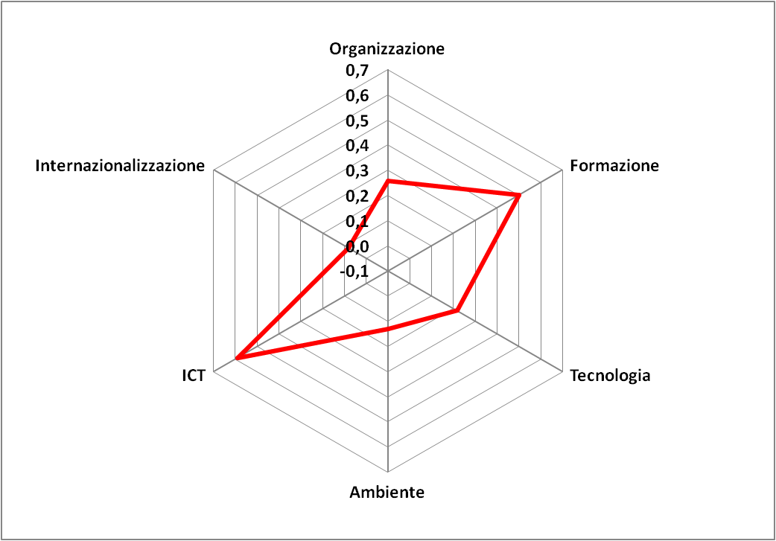
We need to understand the weight of eco innovations
Environmental innovations adoption in industrial firms
Organisational change
HighPerfWorkPract
Internationalisation
training
Techn. innovation
need to understand the joint role of policies, firm internal and external resources, industrial relations, cooperation
Envir. Innov.
Notes:
80

Slide 81
example

Slide 82
the firm’s change of some choice variable may have little effect if other choice variables remain unchanged.

Slide 83
The role of complementarities among different innovation strategies particularly relevant in integrated and more complex green strategies and not only “end of pipe” technology →CO2 abatement
Analysing the relationship between firms’ environmental performance and different innovation practices:
environmental innovations and: process
product
organizational

Slide 84
States of the innovation world
11 | 10
01 | 00
Hall B. Mairesse J. Lotti F. (2012), Evidence on the impact of R&D and ICT investment on innovation and productivity in Italian firms, Economics of Innovation and New Technology, also NBER Working Paper No. 18053 (November 2011).

Slide 85
Effects

Slide 86
Profitability, Productivity, Jobs
Ghisetti-Rennings, 2014, JCP
Gilli M. Mancinelli S. Mazzanti M., 2014, Innovation complementarity and environmental performances: reality or delusion? Evidence from the EU, Ecological Economics
Quatraro – Ghisetti 2013, Ecological Economics
Costantini V. Mazzanti M. 2012, On the green side of trade competitiveness? Research Policy, February, vol.41.
Gagliardi, L. Marin G. and Miriello C. (2014), The Greener the Better: Job Creation and Environmentally- Friendly Technological Change, IEFE Working Paper n. 60, IEFE Milan.
A bunch of papers to be presented at the ISS 2014 in JEna

Slide 87
Turnover and productivity
Cainelli G. Mazzanti M. Zoboli R. 2013, Environmental Performance and Firm Growth in Manufacturing Sectors. Empirical evidence on structural factors and dynamic relationships, Environmental Economics and Policy Studies, October
Cainelli G., Mazzanti M., Zoboli R., 2011, Environmentally-oriented innovative strategies and firm performance in services. Micro-evidence from Italy, International Review of Applied Economics, January.

Slide 88
Regional studies – ecological economics insights
Costantini V. Mazzanti M. Montini A. 2013, Environmental performance, innovation and regional spillovers, Ecological Economics.

Slide 89
Table 3
–
CO
and SO
emission intensity (kg x 1M€ of value added, increasing order)
2
X
Region
CO
Region
SO
2
X
Trentino Alto Adige
136
Trentino Alto Adige
39
Campania
141
Valle d’Aosta
45
Valle d’Aosta
153
Abruzzo
69
Piedmonte
185
Campania
78
Lazio
204
Lomba
rdy
99
Marche
206
Lazio
101
Lombardy
209
Marche
108
Abruzzo
258
Piedmonte
108
Veneto
267
Calabria
123
Emilia Romagna
270
Basilicata
224
Tuscany
278
Emilia Romagna
226
ITALY
301
Molise
276
Calabria
307
Veneto
300
Umbria
342
ITALY
315
Friuli Venezia Giulia
353
Tuscany
349
Basilicata
430
Umbria
373
Liguria
472
Friuli Venezia Giulia
539
Sicily
547
Puglia
859
Molise
689
Liguria
886
Sardinia
824
Sicily
1,347
Puglia
971
Sardinia
1,530
89
V.Costantini, M.Mazzanti, A.Montini - Environmental Performance and Regional Innovation Spillovers
Notes:
89

Slide 90
Shift-Share: productive specialization (industry mix) component
Note: Below zero values indicate positive performances
90
V.Costantini, M.Mazzanti, A.Montini - Environmental Performance and Regional Innovation Spillovers
Notes:
90

Slide 91
Shift-Share: efficiency component
Note: Below zero values indicate positive performances
91
V.Costantini, M.Mazzanti, A.Montini - Environmental Performance and Regional Innovation Spillovers
Notes:
91

Slide 92
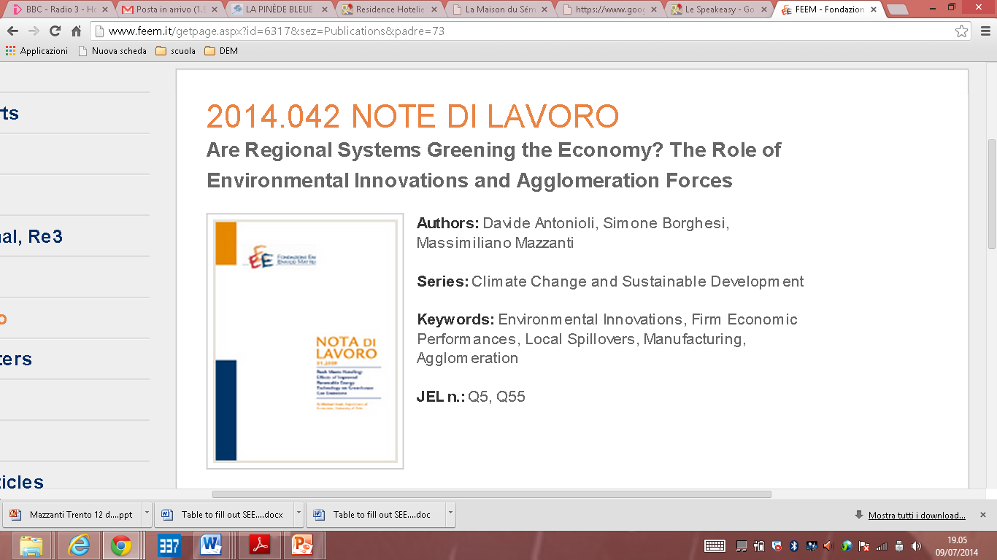

Slide 93
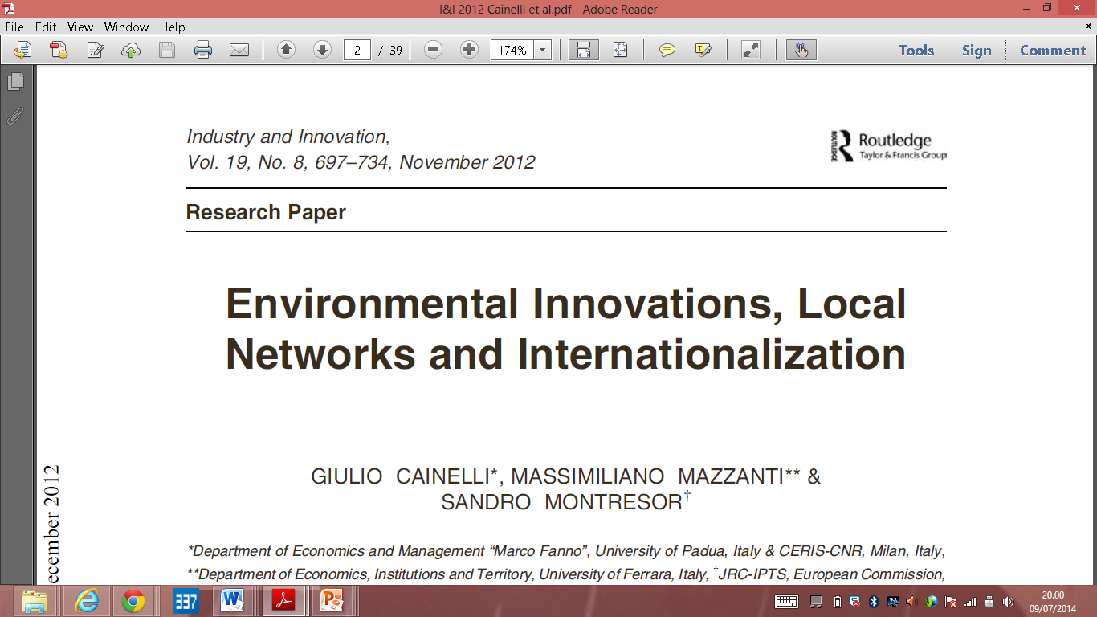

Slide 94
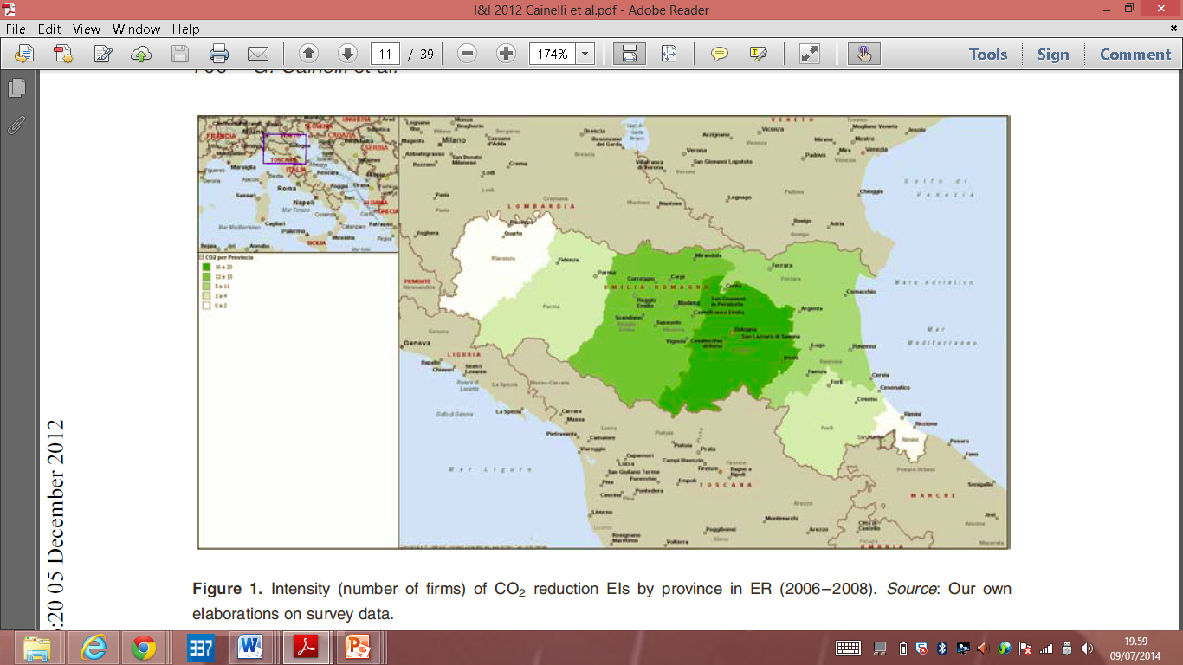

Slide 95

mzzmsm@unife.it

