Slide 1
Migration & Innovation
Francesco Lissoni
GREThA – Université de Bordeaux & CRIOS – Università Bocconi (Milan)
Summer School "Knowledge Dynamics, Industry Evolution, Economic development", 7-13 July 2013, Maison du Séminaire, Nice.

Slide 2
Motivation
Immigration policies and migration shocks have always affected innovation→ e.g. early history of patents (David, 1993); scientists’ run from oppressive regimes (Moser et al., 2011)
Steady increase in the global flows of scientists and engineers (S&Es) over the past 20 years, both in absolute terms and as a percentage of total migration flows (Freeman, 2010; Docquier and Rapoport, 2012)
Hot policy issues:
  Destination countries:
    immigration: selective immigration rules, incl. point-based and other highly-skilled dedicated visas (e.g. H1B in the US)
    higher education : openness to foreign students, incl. choices on education language
    science and research : openness to young foreign scientists, esp. in untenured jobs
  Origin countries:
    “brain drain” threat → restrictions to highly-skilled emigration ; higher education policies (migration as outgoing spillovers)
    “brain gain” opportunities → higher education policies (migration as staple for certain disciplines/institutes) ; pro-returnee policies (incl. adoption of IP legislation, following TRIPs)

Slide 3
Key research questions for destination countries
Do foreign S&Es increase the destination country’s innovation potential, or do they simply displace the local S&E workforce?
Are destination countries increasingly dependent on the immigration of S&Es (including graduate students)?
Does such dependence require the implementation of dedicated immigration policies?
Entry points of foreign S&Es: education, labour market or foreign subsidiaries?

Slide 4
Key research questions for origin countries
Net effect of:
  loss of human capital (“brain drain”)
  (potential) compensating mechanisms:
    Knowledge spillovers from destination countries
    Innovation by returnee S&Es and entrepreneurs
    Role of intellectual property (IP) in promoting (1) and (2) (e.g.Fink and Maskus, 2005)
  IP may attract investors → knowledge spillovers
  IP may promote returnee entrepreneurs
  IP may impede imitation
  Does IP decrease or increase transaction costs? (markets for technologies vs litigation costs)

Slide 5
Today presentation’s objectives
To provide a (selective) overview of main issues and data sources
To assess the potential of patent & inventor data to address existing limitations in empirical analysis
To provide a more detailed application: research on “ethnic spillovers”
→ ALL QUESTIONS WELCOME AT ANY POINT AND TIME!!! (don’t wait till the end of the presentation... & after lunch I go cycling!)

Slide 6
Data sources, with applications

Slide 7
Labour and census data: general and highly skilled migrants
Two datasets of paramount importance:
  Docquier and Marfouk (2006; DM06 → most recent release: Docquier et al., 2009) http://perso.uclouvain.be/frederic.docquier/oxlight.htm
  DIOC 2000* & DIOC 2005/6: Database on Immigrants in OECD countries (http://www.oecd.org/els/mig/dioc.htm; Widmaier and Dumont, 2011)
  * also in extended version (+70 non-OECD countries ; info on scientists and engineers for selected countries)

Slide 8
Similar methodologies: stock of foreign born residents in OECD countries in given years (1990 and 2000 for DM06; 2000 and 2005/6 for DIOC), disaggregated by:
  migrants’ origin country
  age class
  gender
  3 levels of educational attainment
PLUS figures on the number of residents in origin countries
Sources: census data or labour force surveys
→total emigration from any single origin country: f_stock_{j}= ∑_{i}f_stock_{ij}
→foreign born residents in any destination country i: f_stock_{i}= ∑_{j}f_stock_{ij}
BrainDrain_{j} = hsf_stock_{j}/(hsf_stock_{j}+hs_residents_{j})
BrainIntake_{i} = hs_stock_{i}/hs_residents_{i}

Slide 9
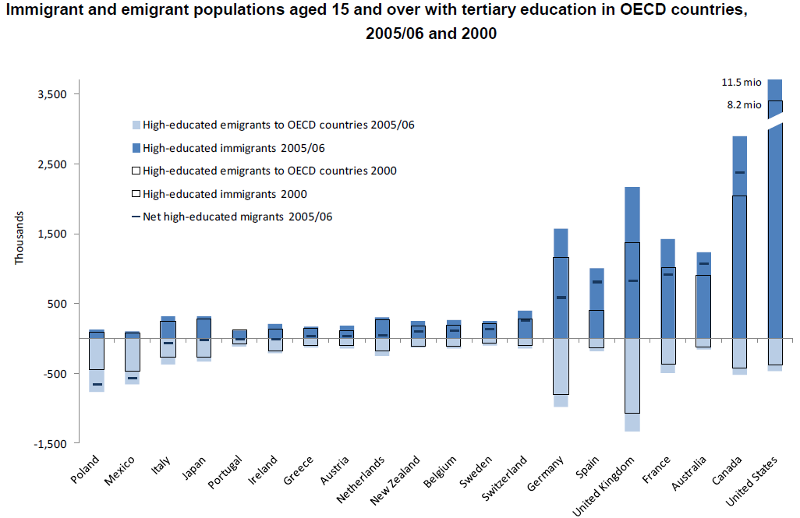
Source: Elaboration on DIOC data by Widmaier S. , Dumont J.-C. (2011)

Slide 10
Labour and census data limitations
Difficulties in defining foreign born individuals (a UK citizen born in Canada by UK parents is counted as foreign-born in census data) PLUS clash with nationality based definition (as in labour surveys)
Information is not available on where foreign born individuals received their tertiary education
Migrants are assigned to the hs category on the basis of their educational attainments (tertiary education), but it is often the case that they accept jobs for which they are overqualified → see evidence by Hunt (2011, 2013) on underemployment of engineering and computer science graduates from LDCs in the US
Aggregate data (no way to further sample the individuals and combine with other info or interviews)

Slide 11
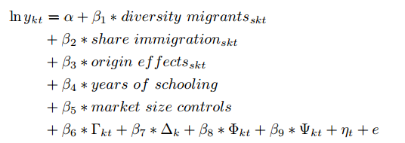
Ethnic diversity and innovation /1
Alesina, et al. 2013
Reciprocal of HH (concentration of residents by country of origin)
y : income or productivity per capita
Γ_{kt} : vector of geographic characteristics
∆_{k} : vector of fractionalization measures
Φ_{kt} : control for institutional development
Ψ_{kt} : vector of controls for trade openness and trade diversity, and
η_{t} : time ﬁxed-eﬀect.
s : overall, skilled, unskilled
t : 1990, 2000
k: countries

Slide 12
Ethnic diversity and innovation /2
Further positive evidence (on Europe)
  Ozgen et al. (2011): 170 NUTS2 regions in Europe, observed over two periods → knowledge production function & aggregate data, no direct evaluation of migration’s impact on innovation
  Niebuhr (2010) : effects of cultural diversity on the patenting rate of 95 German regions over two years (1995 and 1997)
  Works by Ottaviano, Peri, Nathan…

Slide 13
Surveys
Global Science Survey (GlobSci)
Franzoni et al., 2012; Scellato et al., 2012
Survey of authors of papers published in high quality scientific journals in 2008, in 16 top-publishing countries (excl China → 70% worldwide papers)
Key role of foreign authors:
Switzerland (57%)
US % Sweden (38%)
From 33% to 17%: UK, Netherlands, Denmark, Germany, Belgium, and France
Low presence (7%-3%): Spain, Japan, and Italy
Migration within Europe is mainly intra-continental and driven by proximity and language
US as main attractor of Chinese and Indian nationals
Limitation: one-off survey / privacy issues (ltd access) / scientists have been historically a globalised community

Slide 14
Survey on Careers of Doctorate Holders (CDH)
By UNESCO & OECD, 2007 (25 OECD countries; see Auriol, 2007 and 2010)
Some interesting info, but doctoral graduates represent only from 1% to 3% of all tertiary graduates
Survey on the Mobility of European Researchers (MORE)
Report to the European Commission, 2010
Main focus is on academic researchers (data for industrial researchers are based on a non representative sample)
No questions directly relevant for the innovation process.
CV data (esp. for returnees)
Luo et al., 2013: biographical data of Chinese firms’ executives and CEOs to identify returnees
  nr SINO patent _{firm} f (returnee dummies, R&D and controls)
  ceteris paribus, returnee firms patent more

Slide 15
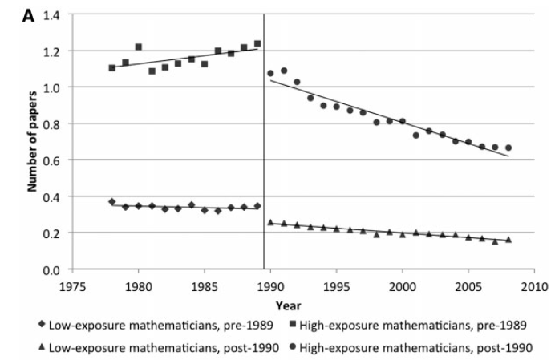
Ad hoc data datasets (mainly for natural experiments)
Borjas and Doran (2012)
End of USSR → Migration of Russian mathematicians into the US
Affiliation and publication data from int’l mathematical societies
Displacement effect for US mathematicians in classic Russian fields

Slide 17
Ad hoc data datasets (mainly for natural experiments)
Moser et al (2014)
Racial laws in Nazi Germany → Migration of Jewish chemists in the US
Historical directories to identify German emigrant chemists
Historical US patents to classify certain technologies as the most affected by migrants upon their arrival
Boost to US patents in those technologies (long-lasting effect)

Slide 19
Patent & Inventor data
Direct measurement of migrants’ contribution to innovation in destination countries
  Weight of foreign inventors in terms of patent shares
  Foreign inventors’ shares of highly cited patents
  (Stephan & Levin 2001, Hunt 2011 & 2103 , No & Walsh, 2010 )
Tracking knowledge flows among inventors from the same origin country, through citation analysis (Kerr 2007 ; Agrawal et al., 2008 and 2011)
Tracking returnee inventors (Agrawal ; Alnuaimi et al., 2012)
KEY TECHNICAL ISSUE: “DISAMBIGUATION” → inventor data applications to immigration lag behind other applications
Key limitation: data apply only to R&D-intensive sectors
High potential
High potential
Low potential

Slide 20
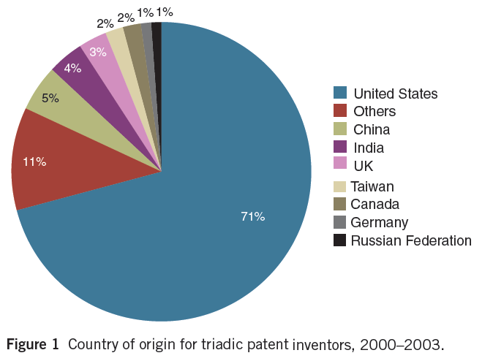
Migrant inventors’ contribution: No & Walsh (2010)
Survey of over 1,900 US-based inventors on ‘triadic’ patents

Slide 21
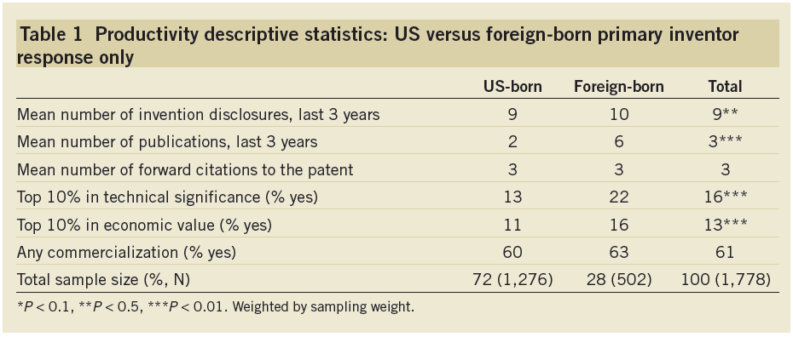
Source: No & Walsh (2010)
Self-evaluation: top 10% / in-between/ top 25% / in-between / top 50% / bottom half → compared to other inventions in the US in their field during that year
The role of self-selection by education: foreign-born individuals are no more likely to invent, once controlling for field and degree (see also Hunt, 2011 and 2013).
BUT foreign inventors’ patent quality is higher than average after controlling for technology class, education level, and firm and project characteristics.

Slide 22
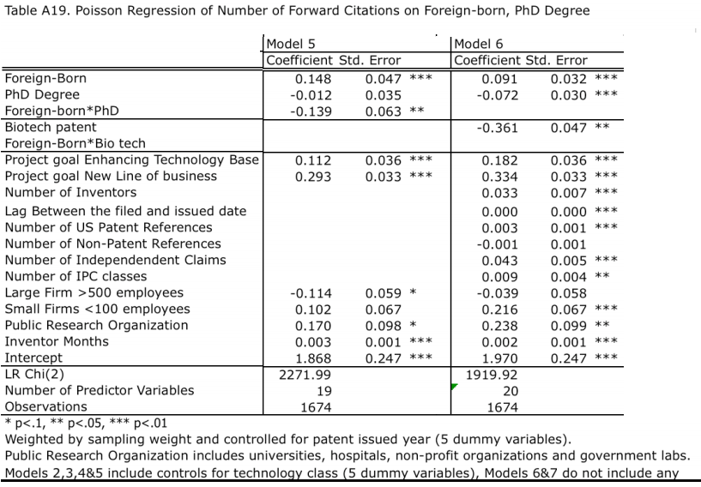

Slide 23
Technical issue 1: NAME DISAMBIGUATION
  Raffo & Luhillery (2009)
  USPTO data: Lai et al. (forth., Research Policy)
  EPO data: Pezzoni et al. (forth., Scientometrics)
  In a nutshell:
FULL NAME | Address | CY | Unique IDs…?
David John Knight | 3 PeachTree Rd, Atlanta GA | US | 1 | 1
David John Knight | 12 Oxford Rd, Manchester | UK | 2 | 1
David J. Knight | Georgia Tech Campus | US | 1 | 1
Knight David John | 3 PeachTree Rd, Atlanta GA | US | 1 | 1

Slide 24
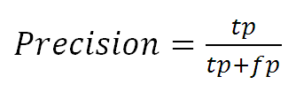
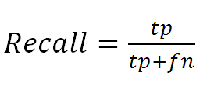
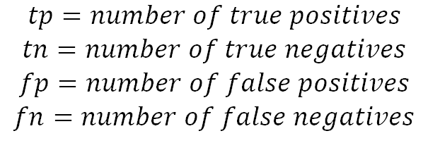
  →Trade-offs between “precision” and “recall”
  where:
  Precision and Recall vary by ethnic group (linguistic rules, naming conventions, frequency of names and surnames)
  E.g.: East-Asians → low precision/high recall
  Russians → high precision/low recall
→For the low precision/high recall ethnic groups, risk of
Over-estimating avg/max inventors’ productivity
Over-estimating the number of returnee inventors
Under-estimating the rate of ethnic citations
The oppostive holds for high precision/low recall ethnic groups

Slide 25
Technical issue 2: ASSIGNING COUNTRY OF ORIGIN
  Non-disambiguated:
  WIPO-PCT dataset: Nationality of inventors
  Kerr’s USPTO dataset : Linguistic analys of surnames (Melissa commercial DB) → “ethnicity”
  Disambiguated:
  Ethnic-Inv “pilot” dataset (Breschi et al., 2013; Breschi & Lissoni, 2014)
    Disambiguated inventor data (public)
      EP-INV database (EPO patents)
      Harvard-IQSS USPTO inventor
      Linguistic analysis of names surnames→ “country of association”
      Swedish inventors (Zheng and Ejermo, 2013)
      Disambiguated inventor (undisclosed data)
      “Big brother” Sweden Statistics information on residents

Slide 26
Country of origin as nationality: the WIPO-PCT database
    Non disambiguated inventor data (by now)
    “Accidental” information on nationality
      PCT (Patent Cooperation Treaty) and the applicant’s nationality requirement
      Pre-AIA (American Invents Act, 2012) “inventor-is-always-applicant” rule at the USPTO
    PCT filings to be extend at the USPTO carry information on the inventor’s nationality
    from 1978 to 2012:
      >2m PCT filings → > 6m relevant records (unique combinations of patent numbers and inventor names)
      of which 81% have info on the inventor’s nationality

Slide 27
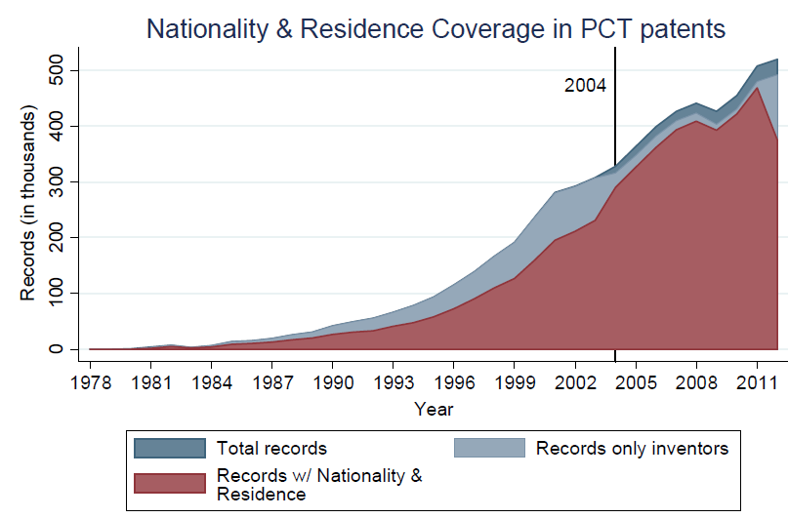
Source: Miguélez and Fink (2013)

Slide 28
Basic evidence from WIPO-PCT
General remarks
Globalization of inventors over the past 20 years
US as most important, and fastest growing destination → evidence even stronger for immigration from non-OECD countries
In Europe: key attractor is UK
Heavy weight of foreign inventors over resident inventors in small, R&D-intensive countries (Switzerland, Belgium, Netherlands…)
Gross vs net emigration → in Europe, largest emigration is from UK and Germany, but largest net emigration is from Italy
Significant brain-drain from low- and middle-income countries, esp. in Africa
NB: this evidence is quite in accordance with evidence from Highly Skilled migration data, but even more extreme for the US

Slide 29
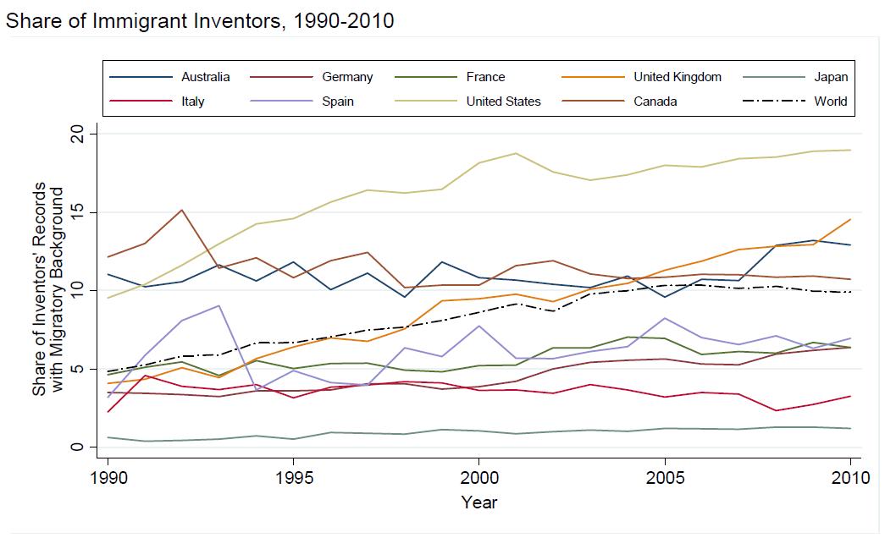
Source: Miguélez and Fink (2013)

Slide 30
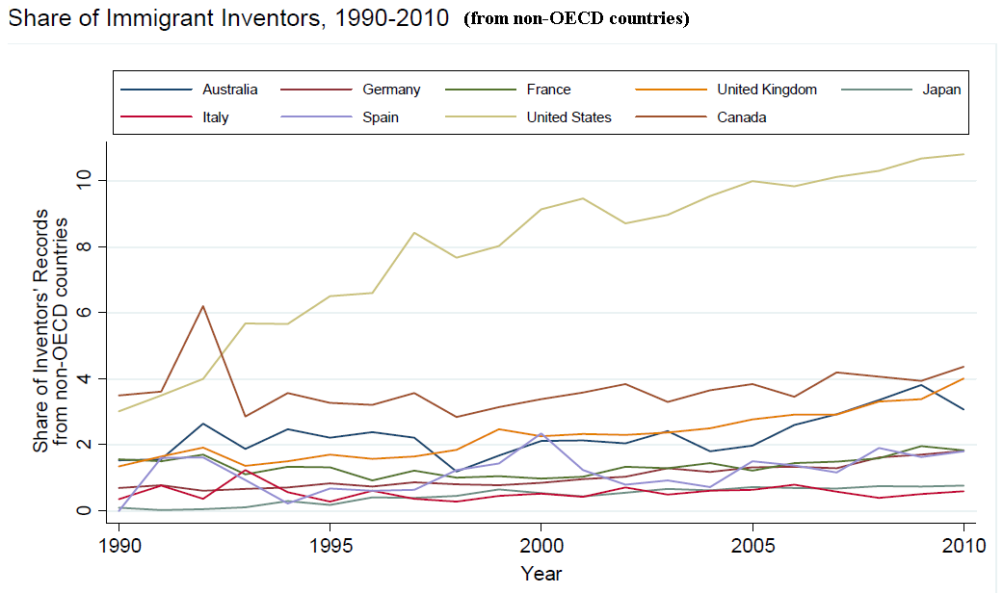
Source: Miguélez and Fink (2013)

Slide 31
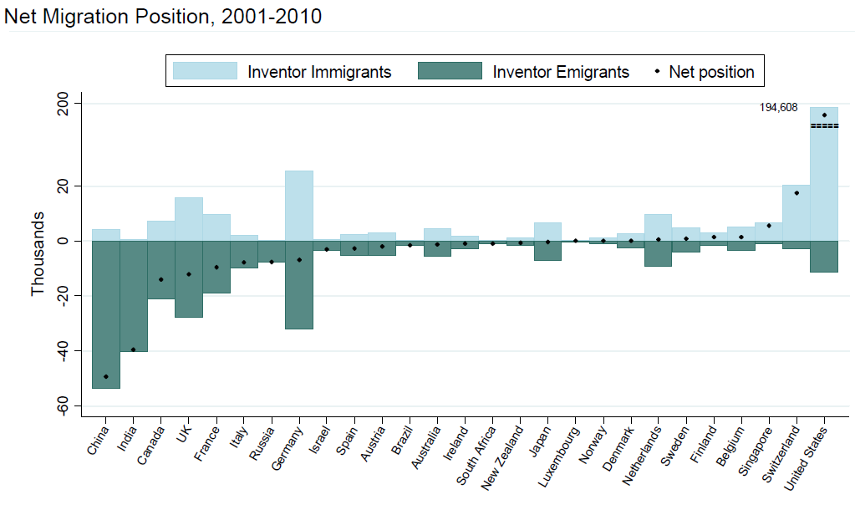
Source: Miguélez and Fink (2013)

Slide 32
Limitations of WIPO-PCT
Nationality vs country of birth (vs country of origin)
  Immigrant inventors can get nationality → correlation with nr of patents signed (f. of length of residency, productivity…)
  Not a problem for aggregate studies, but a serious problem for applications to citation or network analysis
No more data after 2012: AIA steps in, US become a normal country, end of the party
No disambiguation (yet…)

Slide 33
Country of origin as name & surname ethnicity
Kerr (2007) and following papers: USPTO (non-disambiguated) inventor data ←→ Melissa surname database for ethnic marketing ^{(*)}
^{(*)} US-centric vision of “ethnicity” (see figures)
Ethnic-Inv Pilot Database (Breschi et al., 2013): EPO (soon USPTO) disambiguated inventor data ←→ IBM GNR for countries of association
Ad hoc studies by origin country, esp. India, based on ad hoc collection of names (Agrawal et al., 2008 and 2011; Almeida et al., 2010; Alnuaimi et al., 2012)
Untapped names & surnames dataset, from different disciplines:
  Geography: ONOMAP (Cheshire et al., 2011; Mateos et al., 2011)
  Genetics: Piazza et al. (1987)
  Public health: Razum et al. (2001)
  Security and anti-terrorism: Interpol (2006)

Slide 34
Kerr (2007): A pioneer study on “ethnic” inventors
The ethnic inventors’ share of all US-residents’ inventors grows remarkably from 1970s to 2000s: 17% → 29% in the early 2000s
NB: latter figure in the same order of magnitude of estimates of the foreign-born share of doctoral holders in 2003 (26%) but much larger estimates of highly skilled from DIOC 2005/06 (16%)
Fastest growing …
  Ethnic groups: Chinese and Indians
  Technical fields: all science-based and high tech
  Type of applicants: universities (firms catch up later)
Important regional effects → ethnic inventors cluster in metropolitan areas → growing spatial concentration of inventive activity

Slide 35
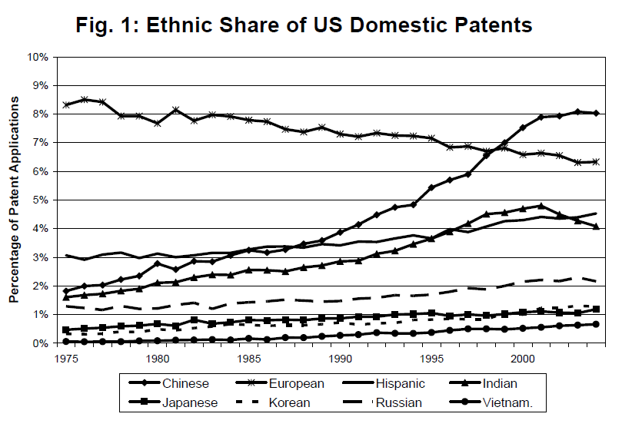

Slide 36
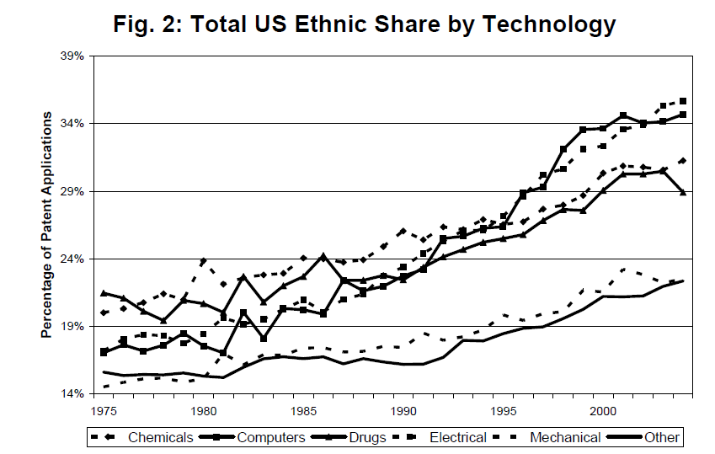

Slide 37
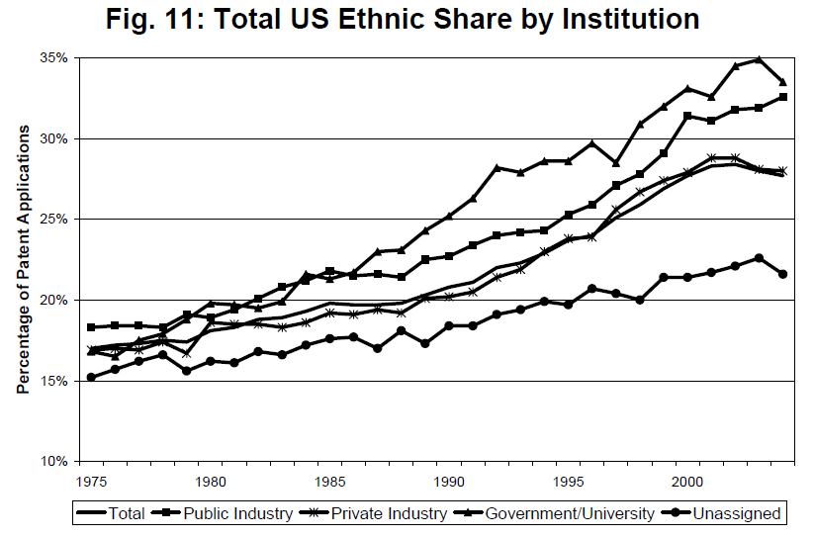

Slide 38
Selected resources (inventor data)
USPTO inventor data:
“classic disambiguation” (2009v): http://hdl.handle.net/1902.1/12367 (ref.: Lai et al., 2009)
“Bayesian disambiguation” (2013v): https://github.com/funginstitute/downloads (ref. Lai et al., 2013)
EPO inventor data (“classic disambiguation”):
http://www.ape-inv.disco.unimib.it/ (ref.: Den Besten et al., 2012; Pezzoni et al., 2012)
WIPO-PCT inventor data (non disambiguated; nationality)
http://www.wipo.int/econ_stat/en/economics/publications.html (ref.: Miguélez and Fink, 2013)

Slide 39
Foreign inventors in the US:
Testing for Diaspora and Brain Gain Effects
Stefano Breschi ¹ , Francesco Lissoni ^{2,1}
¹ CRIOS, Università Bocconi, Milan
² GREThA,Université Montesquieu, Bordeaux IV
3rd CRIOS Conference «Strategy, Organization, Innovation and Entrepreneurship »
Università Bocconi-Milan, June 11-12 2014

Slide 40
Motivation
To investigate the role of diasporas in knowledge diffusion, with reference to the specific case of:
Migrant inventors in the US, from Asia and Europe
Local vs international knowledge flows
  Local: relative weight of “ethnic” ties vs physical proximity (co-location) and social closeness on the network of inventors
  International: ethnic & social ties vs multinationals and returnees

Slide 41
Outline
Background
Research questions & tests
“Ethnic” inventor data
Results
Conclusions
-------------------------
Back-up slides: IPC groups / networks of inventors / name disambiguation / ethnic matching

Slide 42
1. Background /i
Geography of innovation → Localized Knowledge Spillovers (LKS)
  Jaffe & al.’s (1993) test on co-localization of patent citations (JTH test → Thompson & Fox-Kean, 2005; Alcacer & Gittelman, 2006; Singh & Marx, 2013)
  Role of social proximity: co-inventorship, inventors’ mobility and networks of inventors (Almeida & Kogut, 1999; Agrawal & al., 2006; Breschi & Lissoni, 2009)
  “Ethnicity” as further instance of social proximity (Agrawal & al., 2008; Almeida & al., 2010)
Migration studies → Brain gain vs Brain
  Brain gain channels: MNEs (Fink & Maskus, 2005; Foley & Kerr, 2011); diaspora associations (Meyer, 2001); returnee migration (Alnuaimi & al., 2012; Nanda a& Khanna, 2010); returnee entrepreneurship (Saxenian, 2006; Kenney & al., 2013)
  Home country’s citations to patents by migrant (“ethnic”) inventors (Kerr, 2008; Agrawal et al., 2011)

Slide 43
1. Background /ii
Geography of innovation
  Weak evidence of inventor co-ethnicity’s correlation to diffusion (probability to observe a citation between two patent)
  Co-ethnicity as substitute for co-location
  Exclusive focus on India → reminds of classic research question in migration studies: is the Indian diaspora exceptional?
Migration studies
  Evidence of inventor’s home-country bias in diffusion patterns, albeit stronger for China and India (possibly only in Electronics and IT)
  US-bias as destination country & China/India bias as CoO

Slide 44
2. Research questions & tests /i
DIASPORA EFFECT: foreign inventors of the same ethnic group and active in the same country of destination have a higher propensity to cite one another’s patents, as opposed to patents by other inventors, other things being equal and excluding self-citations at the company level.
BRAIN GAIN EFFECT: patents by foreign inventors of the same ethnic group and active in the same country of destination also disproportionately cited by inventors in their countries of origin
INTERACTIONS: how do these effects interact with individuals’ location in space and on the network of inventors?

Slide 45
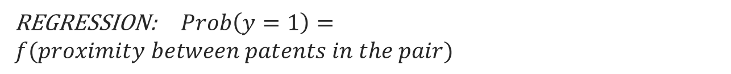

2. Research questions & tests /ii
Basic test:
y = citation
=1
=0
Ethnic inventors’
cited patents
Citing patents
Control patents
(same year & IPC group)
$$OBSERVATIONS:patent pairs$$
REGRESSION: $Prob\left(y=1\right)=f(proximity between patents in the pair)$

Slide 46
2. Research questions & tests /iii
DIASPORA TEST:
Citing patents from within the US
(“local” sample)
Ethnic inventors’
cited patents
Control patents
(same year & IPC group)
$$Prob\left(y=1\right)=f(co−ethnicity,spatial proximity,social proximity)$$
Ethnic-INV algorithm
Co-location at BEA level (n≥1 inventor per patent)
Min geodesic distance btw inventor teams (back-up slides)

Slide 47
2. Research questions & tests /iii
DIASPORA TEST:
Citing patents from outside the US
(“international” sample)
Ethnic inventors’
cited patents
Control patents
(same year & IPC group)
$$Prob\left(y=1\right)=f(co−ethnicity,spatial proximity,social proximity)$$
Ethnic-INV algorithm
EEE-PPAT harmonization
Min geodesic distance btw inventor teams (back-up slides)

Slide 48
3. Data /i
EP-INV database: ≈3 million uniquely identified (i.e. “disambiguated”) inventors from EPO patents (1978-2011; Patstat 10/2013 edition)
+
IBM Global Name Recognition (GNR) system: 750k full names + computer-generated variants → For each name or surname:
(long) list of “countries of association” (CoAs) + statistical information on cross-country and within-country distribution
elaboration on (1) with our own algorithms (→ back-up slides)

Slide 49
Ethnic-INV algorithm /i
Ethnic-INV algorithm
EP-INV
(disambiguated
inventor data)
IBM
GNR
data
Ethnic inventor
data set
For the analysis next, we chose the combination of parameters with the highest recall rate, conditional on a precision rate greater than 30%

Slide 50
Ethnic-INV algorithm /ii
Surname | Country of Association | Frequency | Significance
LAROIA | INDIA | 10 | 99
LAROIA | FRANCE | 10 | 1
LAROIA RAJIV
EP-INV
(disambiguated
inventor data)
IBM
GNR
Data
First name | Country of Association | Frequency | Significance
RAJIV | INDIA | 90 | 81
RAJIV | GREAT BRITAIN | 50 | 10
RAJIV | SRI LANKA | 50 | 1
RAJIV | TRINIDAD | 30 | 1
RAJIV | AUSTRALIA | 10 | 1
RAJIV | CANADA | 10 | 1
RAJIV | NETHERLANDS | 10 | 1

Slide 51
Ethnic-INV algorithm /iii
To identify a unique country of origin, we build 3 measures
Surname | Country of Association | Frequency | Significance
LAROIA | INDIA | 10 | 99
LAROIA | FRANCE | 10 | 1
Country of Association | JOINT Significance (1) | Significance of surname (2) | Max frequency of first name in Anglo/Hispanic countries (3)
INDIA | 8019 | 99 | 50
FRANCE | 0 | 1 | 50
GREAT BRITAIN | 0 | 0 | 50
SRI LANKA | 0 | 0 | 50
TRINIDAD | 0 | 0 | 50
AUSTRALIA | 0 | 0 | 50
CANADA | 0 | 0 | 50
NETHERLANDS | 0 | 0 | 50
First name | Country of Association | Frequency | Significance
RAJIV | INDIA | 90 | 81
RAJIV | GREAT BRITAIN | 50 | 10
RAJIV | SRI LANKA | 50 | 1
RAJIV | TRINIDAD | 30 | 1
RAJIV | AUSTRALIA | 10 | 1
RAJIV | CANADA | 10 | 1
RAJIV | NETHERLANDS | 10 | 1

Slide 52
Ethnic-INV algorithm /iv
LAROIA RAJIV
LAROIA RAJIV
Country of Association | JOINT Significance (1) | Significance of surname (2) | Max frequency of first name in Anglo/Hispanic countries (3)
INDIA | 8019 | 99 | 50
 | Do indicators (1)-(3) pass all thresholds? | Country of Origin = INDIA ?
High Recall | Yes | Yes
High Precision | No | No
 | THRESHOLDS (India-specific)
 | (1) | (2) | (3)
High Recall | 5000 | 60 | 30
High Precision | 8000 | 80 | 70

Slide 53
3. Data /ii
 | nr | %
China | 97891 | 16.30
India | 63964 | 10.65
S. Korea | 28796 | 4.79
United Kingdom | 28122 | 4.68
Germany | 26829 | 4.47
Canada | 24660 | 4.11
Taiwan | 22155 | 3.69
Russian Federation | 20497 | 3.41
Iran | 14627 | 2.44
Mexico | 11924 | 1.99
Japan | 11616 | 1.93
Philippines | 11576 | 1.93
France | 10752 | 1.79
Cuba | 9852 | 1.64
Viet Nam | 8403 | 1.40
Italy | 8309 | 1.38
Poland | 7776 | 1.29
Ukraine | 7234 | 1.20
Egypt | 6834 | 1.14
Puerto Rico | 6699 | 1.12
10 Countries of Origin (CoO)
  Listed by OECD among top 20 CoO of highly skilled migrants to the US
  Neither English- nor Spanish-speaking
  We exclude:
    Vietnam and Egypt (low figures)
    Ukraine and Taiwan (may re-include them, along with Switzerland & Austria)
Source: Database on Immigrants in OECD Countries (DIOC), 2005/06.

Slide 54
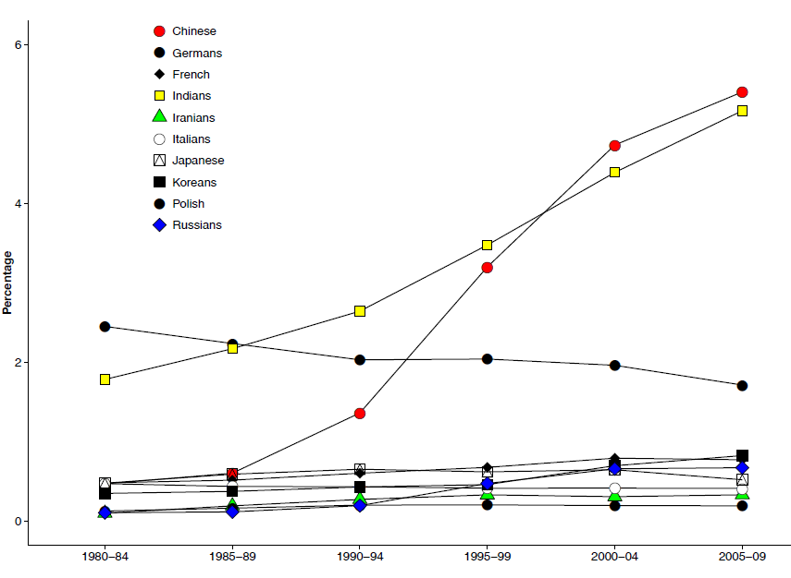
Figure A3.1 – Share of ethnic inventors of EPO patent applications by US residents; by CoO

Slide 55
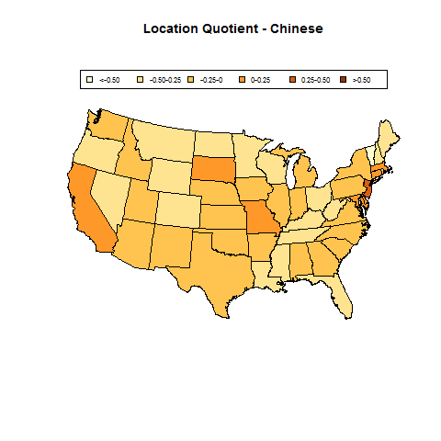
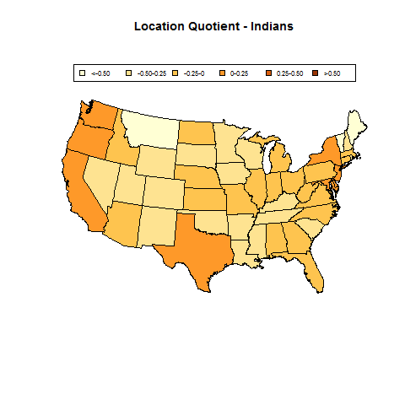

Slide 56
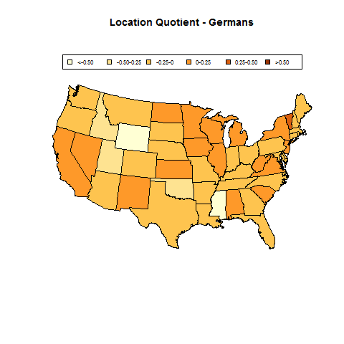
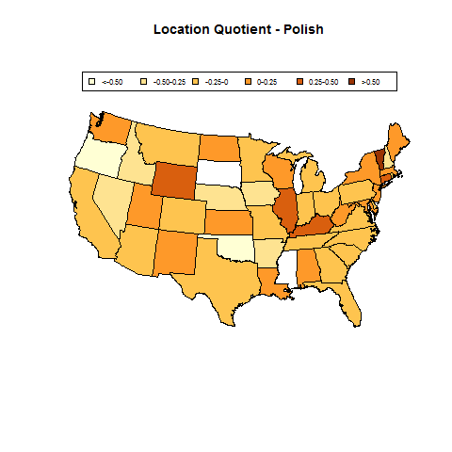

Slide 57
Table 2. Local and international samples: descriptive statistics
 | Obs | Mean | Std. Dev. | Min | Max
1. Local sample (citations from within the US)
Citation | 1211154 | 0.500 | 0.500 | 0 | 1
Co-ethnicity | 1211154 | 0.120 | 0.325 | 0 | 1
Social distance 0 | 1211154 | 0.013 | 0.114 | 0 | 1
Social distance 1 | 1211154 | 0.012 | 0.109 | 0 | 1
Social distance 2 | 1211154 | 0.008 | 0.089 | 0 | 1
Social distance 3 | 1211154 | 0.009 | 0.093 | 0 | 1
Social dist. >3 | 1211154 | 0.236 | 0.425 | 0 | 1
Social distance +∞ | 1211154 | 0.722 | 0.448 | 0 | 1
Co-location | 1211154 | 0.172 | 0.377 | 0 | 1
96k cited patents
216k citing

Slide 58
Table 2. Local and international samples: descriptive statistics (cont.)
 | Obs | Mean | Std. Dev. | Min | Max
2. International sample (citations from outside the US)
Citation | 1084120 | 0.500 | 0.500 | 0 | 1
Co-ethnicity | 1084120 | 0.081 | 0.272 | 0 | 1
Social distance 0 | 1084120 | 0.004 | 0.063 | 0 | 1
Social distance 1 | 1084120 | 0.005 | 0.072 | 0 | 1
Social distance 2 | 1084120 | 0.004 | 0.066 | 0 | 1
Social distance 3 | 1084120 | 0.005 | 0.068 | 0 | 1
Social distance >3 | 1084120 | 0.200 | 0.400 | 0 | 1
Social distance +∞ | 1084120 | 0.781 | 0.413 | 0 | 1
Same country | 1084120 | 0.085 | 0.279 | 0 | 1
Same company | 1084120 | 0.024 | 0.152 | 0 | 1
Returnee | 1084120 | 0.0005 | 0.022 | 0 | 1
106k cited
272k citing

Slide 59
4. Results
DIASPORA EFFECT:
  positive and significant for all CoO in our sample, except France, Italy, and Poland
  BUT result is not robust to all model specifications, safe for India and China
  marginal effect of co-ethnicity is secondary to that of social proximity and co-location
  Co-ethnicity acts as substitute for physical proximity, and kicks in at large social distances
BRAIN GAIN EFFECT:
  Mixed results: positive and significant for all Asian countries (but Iran) and Russia, but negative or null for the other European countries (unless “same country” replaced by “country of origin)
  Largest marginal effect belongs to company self-citations
  Co-ethn. as substitute for company self-citations, and kicks in at large social distances

Slide 60
DIASPORA EFFECT:– Logit regression, by Country of Origin
 | China | India | Iran | Japan | Korea
Co-location | 0.39*** | 0.41*** | 0.47*** | 0.38*** | 0.34***
Co-ethnicity | 0.34*** | 0.18*** | 0.27** | 0.17*** | 0.19***
Co-ethn*Co-loc | -0.12*** | -0.09*** | 0.15 | -0.09 | -0.10
Soc. dist. 1 | -1.59*** | -1.04*** | -1.66*** | -1.36*** | -0.59**
Soc. dist. 2 | -2.44*** | -1.88*** | -2.07*** | -2.29*** | -1.18***
Soc. dist. 3 | -2.86*** | -2.21*** | -2.54*** | -2.98*** | -2.13***
Soc. dist.>3 | -3.64*** | -3.14*** | -3.60*** | -3.70*** | -2.86***
Soc. dist. +∞ | -3.80*** | -3.24*** | -3.64*** | -3.79*** | -2.97***
Constant | 3.55*** | 3.07*** | 3.48*** | 3.65*** | 2.83***
Observations | 291,804 | 373,126 | 33,128 | 56,234 | 59,456
Chi-sq | 9372 | 8478 | 827.9 | 1012 | 1284
LogL | -195260 | -252246 | -22308 | -38039 | -40205
Pseudo R-sq | 0.0346 | 0.0247 | 0.0285 | 0.0241 | 0.0244
The table reports estimated parameters (βs) ; Robust standard errors in parentheses ; *** p<0.01, ** p<0.05, * p<0.1

Slide 61
DIASPORA EFFECT:– Logit regression, by Country of Origin (cont.)
 | Germany | France | Italy | Poland | Russia
Co-location | 0.44*** | 0.39*** | 0.40*** | 0.30*** | 0.47***
Co-ethnicity | 0.04** | 0.03 | 0.04 | -0.22 | 0.29***
Co-ethn*Co-loc | -0.04 | 0.04 | -0.17 | -0.14 | 0.09
Soc. dist. 1 | -1.13*** | -1.29*** | -0.78** | -0.29 | -1.25***
Soc. dist. 2 | -1.90*** | -1.87*** | -1.76*** | -1.87*** | -1.69***
Soc. dist. 3 | -2.54*** | -2.50*** | -2.40*** | -2.12*** | -2.38***
Soc. dist.>3 | -3.19*** | -3.16*** | -3.23*** | -3.10*** | -3.14***
Soc. dist. +∞ | -3.30*** | -3.30*** | -3.33*** | -3.19*** | -3.30***
Constant | 3.15*** | 3.14*** | 3.20*** | 3.05*** | 3.11***
Observations | 205,858 | 77,038 | 53,168 | 19,078 | 42,264
Chi-sq | 4667 | 1705 | 1017 | 480.6 | 1195
LogL | -138992 | -52094 | -36024 | -12782 | -28368
Pseudo R-sq | 0.0259 | 0.0244 | 0.0225 | 0.0334 | 0.0317
The table reports estimated parameters (βs) ; Robust standard errors in parentheses ; *** p<0.01, ** p<0.05, * p<0.1

Slide 62
DIASPORA EFFECT: → interaction “social distance” * “co-ethnicity”
 | China | Germany | India
Co-location | 0.41*** | 0.45*** | 0.42***
Co-ethnicity | -0.29*** | 0.06 | -0.20***
Co-ethn*Co-loc | -0.10*** | -0.05 | -0.07***
Soc. distance >3 | -1.91*** | -1.66*** | -1.78***
Soc. distance +∞ | -2.02*** | -1.76*** | -1.88***
Co-ethn*Soc. Distance>3 | 0.76*** | 0.002 | 0.418***
Co-ethn.*Soc. Distance +∞ | 0.55*** | -0.03 | 0.37***
Constant | 1.78*** | 1.61*** | 1.71***
Observations | 291,804 | 205,858 | 373,126
Chi-sq | 11787 | 5730 | 10150
LogL | -195749 | -139315 | -252663
Pseudo R-sq | 0.0322 | 0.0237 | 0.0231
Same results for other CoO
The table reports estimated parameters (βs) ; Robust standard errors in parentheses ; *** p<0.01, ** p<0.05, * p<0.1

Slide 63
DIASPORA EFFECT:
→ estimated probability of citation (interaction “social distance” * “co-ethnicity”)

Slide 64
BRAIN GAIN EFFECT:– Logit regression, by Country of Origin
 | China | Germany | France | India | Italy | Japan | Korea | Russia
Co-ethnicity | 0.37* | 0.83*** | 0.87*** | 1.05*** | 0.46 | 0.17 | -0.30 | 1.67
Same company | 1.22*** | 1.06*** | 1.25*** | 1.16*** | 0.94*** | 1.36*** | 0.99*** | 1.23***
Soc. dist.>3 | -1.10*** | -0.75*** | -0.90*** | -0.99*** | -1.17*** | -1.34*** | -1.33*** | -0.77***
Soc. dist. +∞ | -1.26*** | -0.74*** | -0.97*** | -1.10*** | -1.31*** | -1.37*** | -1.50*** | -0.98***
Co-ethn*Soc. dist.>3 | 0.14 | -0.43*** | -0.36* | -0.55* | -0.38 | 0.28 | 0.04 | -0.80
Co-ethn.*Soc. dist. +∞ | -0.03 | -0.59*** | -0.60*** | -0.71** | -0.36 | 0.03 | 0.72* | -1.07
Constant | 1.17*** | 0.62*** | 0.87*** | 1.04*** | 1.24*** | 1.25*** | 1.41*** | 0.90***
Observations | 265,116 | 183,419 | 70,328 | 327,368 | 47,806 | 54,944 | 50,928 | 39,433
Chi-sq | 3277 | 3192 | 1187 | 3007 | 522.7 | 1172 | 613.9 | 468
LogL | -181671 | -125047 | -47900 | -225036 | -32803 | -37246 | -34928 | -27070
Pseudo R-sq | 0.0114 | 0.0164 | 0.0174 | 0.00828 | 0.0101 | 0.022 | 0.0106 | 0.00963
The table reports estimated parameters (βs) ; Robust standard errors in parentheses ; *** p<0.01, ** p<0.05, * p<0.1

Slide 65
BRAIN GAIN EFFECT:
→ estimated probability of citation (with company self-citations)

Slide 66
5. Conclusions & further research
Findings on diaspora effects for India (and China) are compatible with Agrawal et al.’s (2008) as well as our own research on social distance → mixed evidence for other countries may be due to quality of ethnic-inv algorithm
Findings on brain gain effects for India (less so for China) are compatible with Kerr’s (2008), and we highlight the role of MNEs → mixed evidence for other countries may be due to quality of ethnic-inv algorithm and company names’ harmonization
Further research:
  Data quality issues
  Additional topics: skill-bias immigration hypothesis

Slide 67
Back-up slides

Slide 68
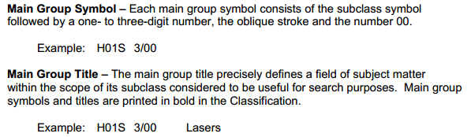
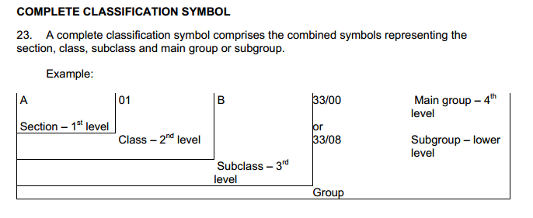
IPC groups

Slide 69
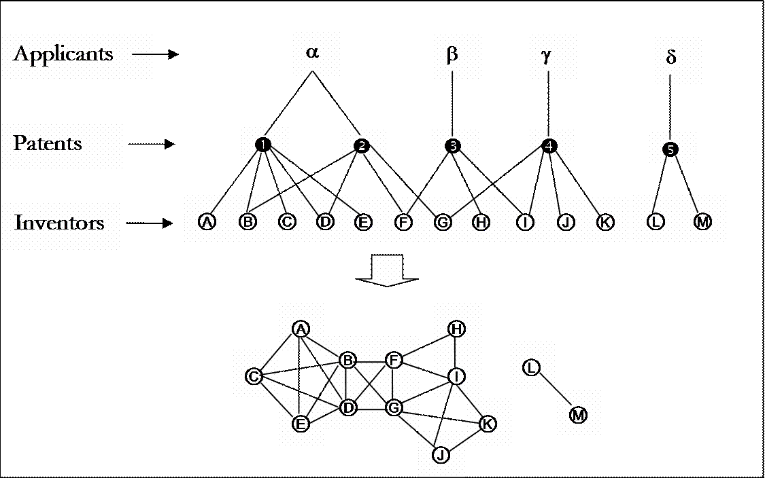
Network of inventors: co-invention & mobility
Two 2-mode (affiliation) networks:
Inventors to Patents
Patents to Applicants
cross-firm inventors
1-mode network of inventors

Slide 70
Social distance between patents
What is the distance
between patent 1 and patent 4?
The shortest path connecting
inventors in the two teams
d(1,4)=1

Slide 71
Inventor name disambiguation /i
TADEPALLI ANJANEYULU SEETHARM
TADEPALLI ANJANEYULU SEETHARAM
Matching by name
and surname
LAROIA RAJIV QUALCOMM INCORPORATED
LAROIA RAJIV
Raw
EPO
data
KNIGHT DAVID JOHN
KNIGHT JOHN D.
Filtering
Disambiguated
EPO
data
Addresses on patents
Technological classes of patents
Social networks
Citation linkages

Slide 72
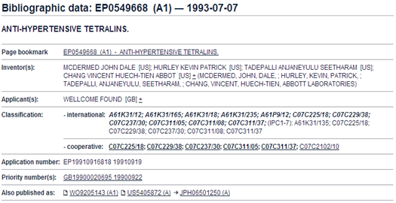
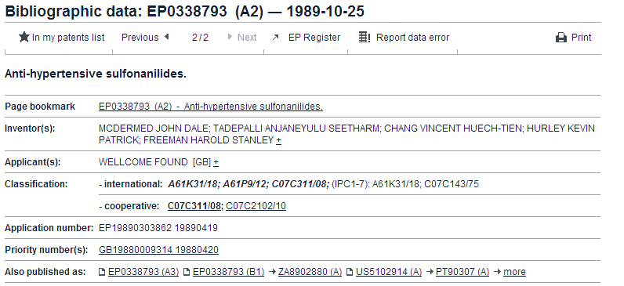
Inventor name disambiguation /ii
Without careful disambiguation,
this pair will count as a co-ethnic citation, whereas it is just a personal self-citation
citing patent
cited patent

Slide 73
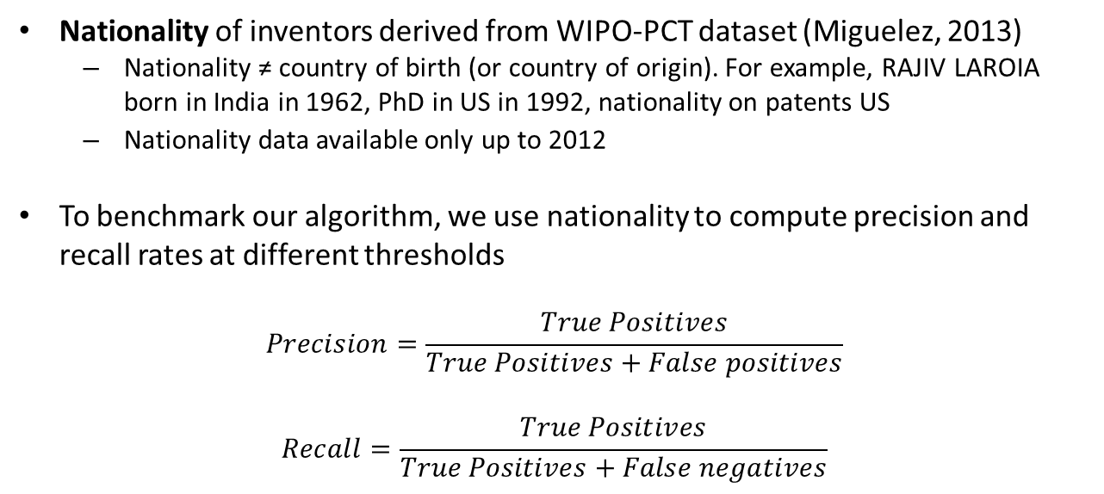
Ethnic-INV algorithm /v
Nationality of inventors derived from WIPO-PCT dataset (Miguelez, 2013)
  Nationality ≠ country of birth (or country of origin). For example, RAJIV LAROIA born in India in 1962, PhD in US in 1992, nationality on patents US
  Nationality data available only up to 2012
To benchmark our algorithm, we use nationality to compute precision and recall rates at different thresholds
  $$Precision=\frac{True Positives}{True Positives+False positives}$$
$$Recall=\frac{True Positives}{True Positives+False negatives}$$

Slide 74
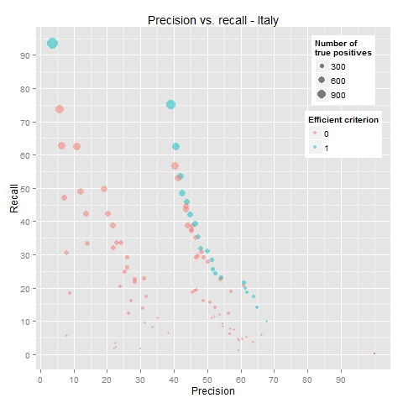
Dots: combination of parameters
Blue dots: efficient combinations
Joint significance: 1000
Significance surname: 0
Frequency first name: 100
Joint significance: 1000
Significance surname: 0
Frequency first name: 10

Slide 75
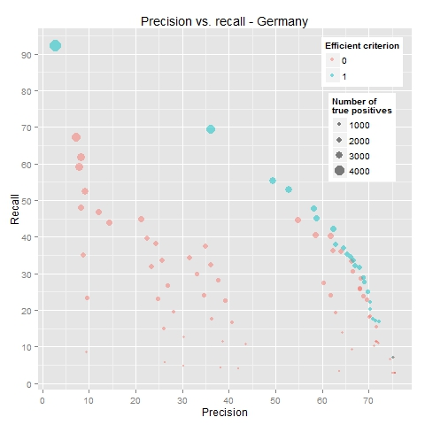

Slide 76
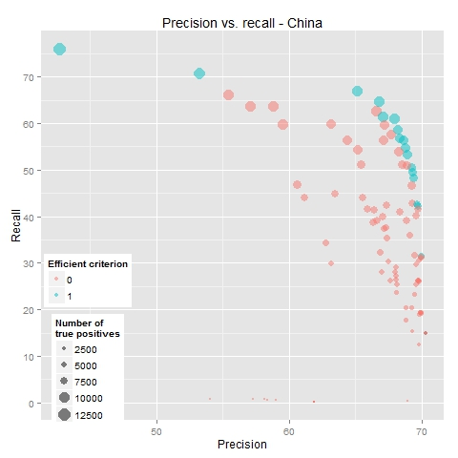

Slide 77
