Slide 1
Understanding Firm Growth – some recent results and some challenges ahead
Alex COAD
SPRU & Aalborg Univ.
Nice, 7 July 2014
14:00-15:00

Slide 2
Regularities in industry structure
  Firm size distribution
    right-skewed
    lognormal or Pareto distributions
  Age distribution
    exponential
  Growth rates distribution
    tent-shaped on logarithmic axes
    Laplace (symmetric exponential)

Slide 3
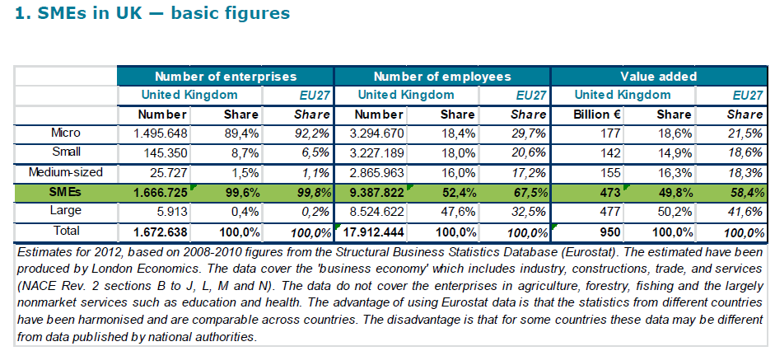
Firm size distribution
(Source: SBA fact sheet 2013)

Slide 4
Power law distribution (Axtell 2001 Science)

Slide 5
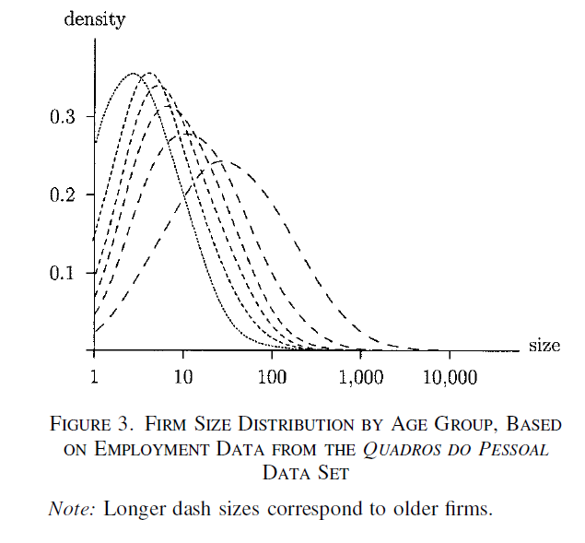
Evolution of the FSD: Cabral and Mata 2003 AER

Slide 6
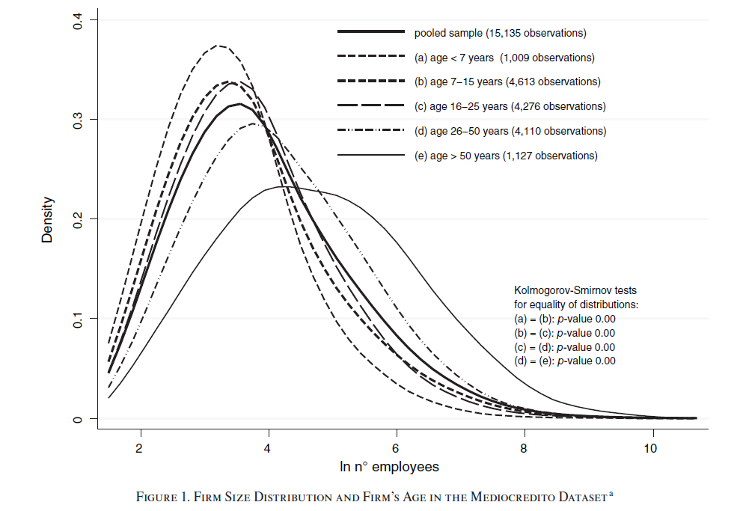
Evolution of the FSD: Angelini & Generale 2008 AER

Slide 7
Age distribution
Firms have a positive probability of exit in each year after birth.
Assume the death rate λ is constant (questionable…)
Assume a constant number of entrants each year
This leads to an exponential age distribution

Slide 8
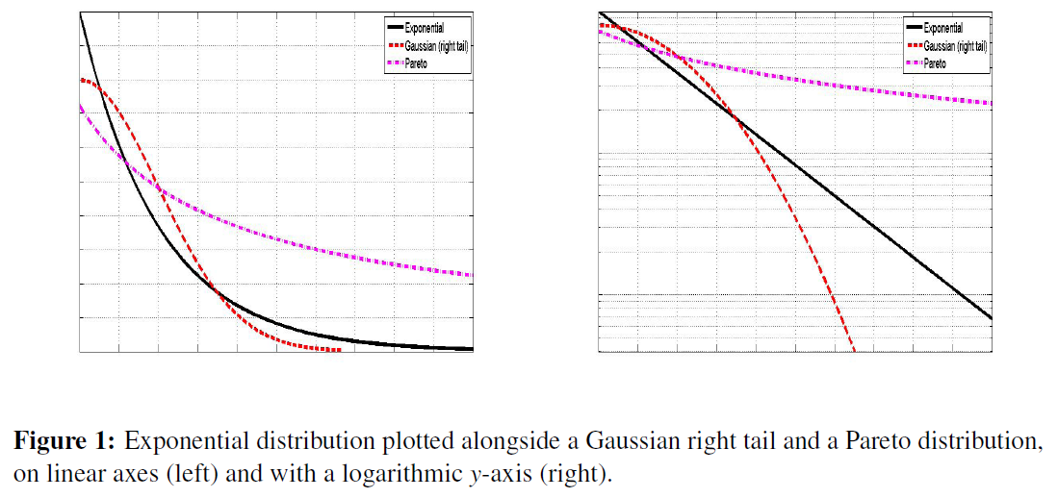

Slide 9
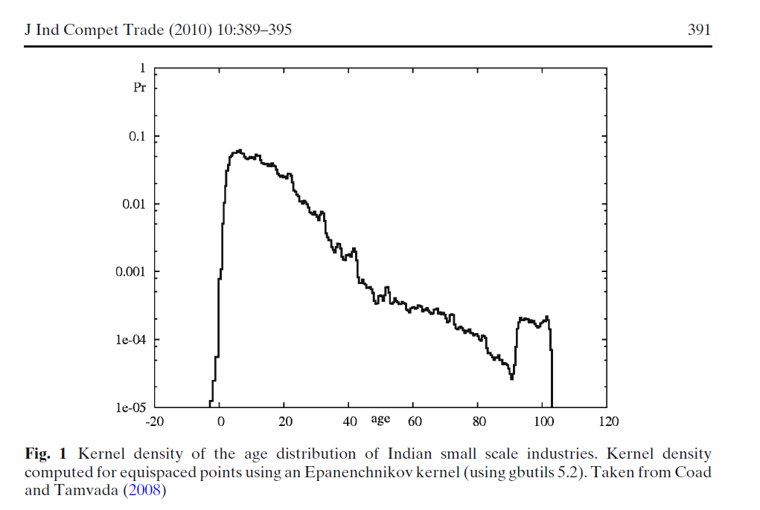

Slide 10
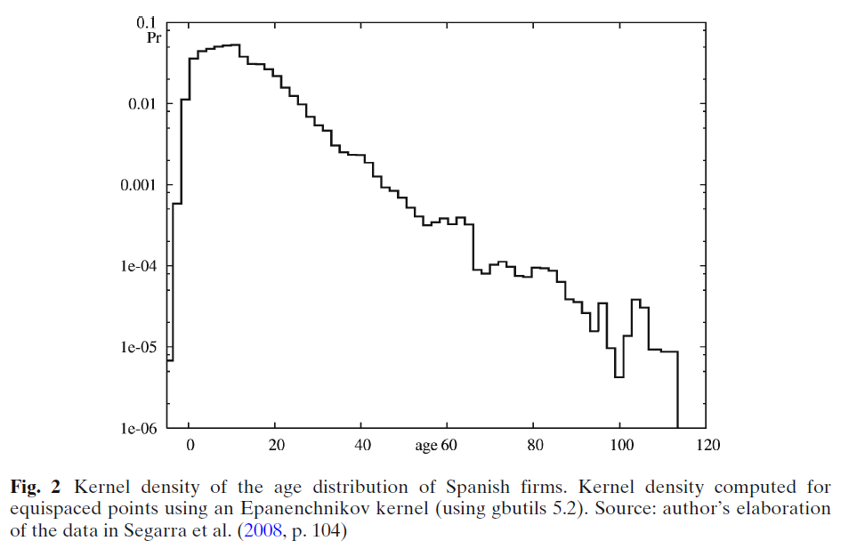

Slide 11
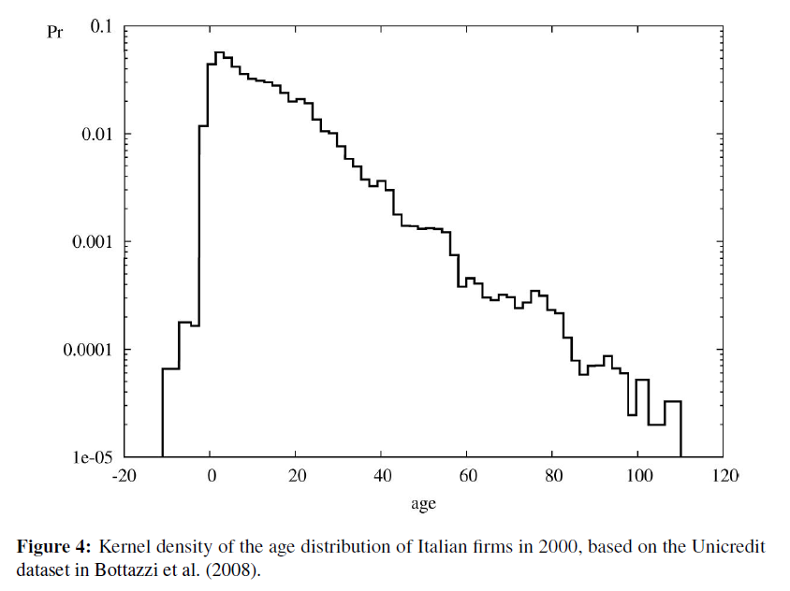

Slide 12
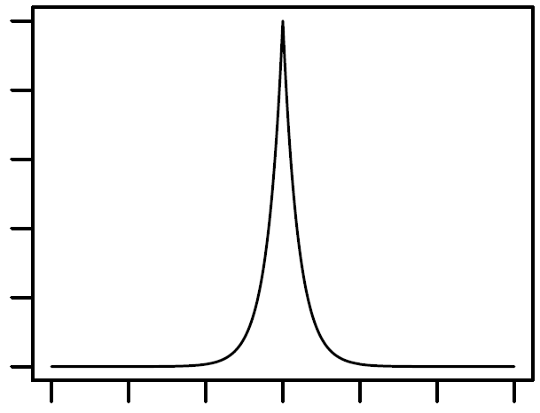
Growth rate distribution
Little/no growth
Fast decline
Fast growth

Slide 13
Exponential Distribution
Log y
Exponential
Normal
(Gaussian)
x

Slide 14
Laplace Distribution (symmetric exponential)
Log y
Laplace
Normal
(Gaussian)
x

Slide 15
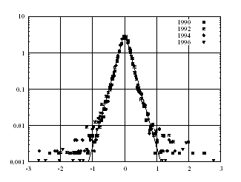
Sales growth in Italian Manufacturing
Bottazzi-Cefis-Dosi-Secchi 2007 SBE

Slide 16
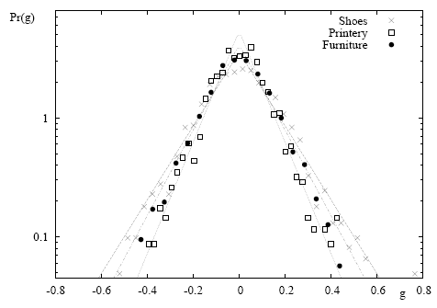
Disaggregated by industry
Bottazzi-Secchi 2006 Rand J Econ

Slide 17
Lumpiness of investment
  Analysis of US plants: “on average, half of a plant’s total investment over the 1973-1988 period was performed in just three years.” (Doms and Dunne 1998 RED, p417)
  while 52.9 per cent of plants increase their capital stock by less than 2.5 per cent in a year, 11 per cent of plants increase their capital stock by more than 20 per cent

Slide 18
Growth rate distributions
Heavy tailed ‘tent-shaped’ distributions, well approximated by the Laplace density
“tent shape, so what?..”
Bottazzi-Cefis-Dosi 2002 ICC p720
“market selection seems to operate quite gently, if at all, vis-à-vis most 'near-average' agents… selection dynamics are primarily driven by outliers”
Metcalfe 2005 WP p10
"evolution takes place most sharply in the population tails and the more a population is distributed in the tails then the greater is the scope for the distance from mean dynamic to work.”
Quantile regressions show that fast-growth firms have different characteristics (innovation, strong negative growth autocorrelation, younger, etc)

Slide 19
Small number of high-growth firms
  4% of firms create about 50% of jobs (Storey, 1994)
  But it is extremely difficult to pick them out ex ante
  “43 people have to try to start companies so that we can have 9 jobs a decade from now. That's not the spectacular yield you might think we'd get if you read the press reports about the job creation of start-ups.”
    Shane (2009, P144)

Slide 20
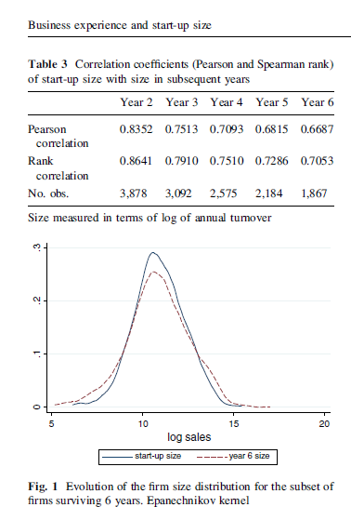
Most firms don’t grow: the importance of start-up size
Coad, Frankish, Nightingale, Roberts 2014 SBE
Start-up size highly correlated with size in subsequent years

Slide 21

Steady growth is the norm?

Slide 22
Growth is largely random
“The most elementary ‘fact’ about corporate growth thrown up by econometric work on both large and small firms is that firm size follows a random walk.”
Geroski (2000: 169)

Slide 23
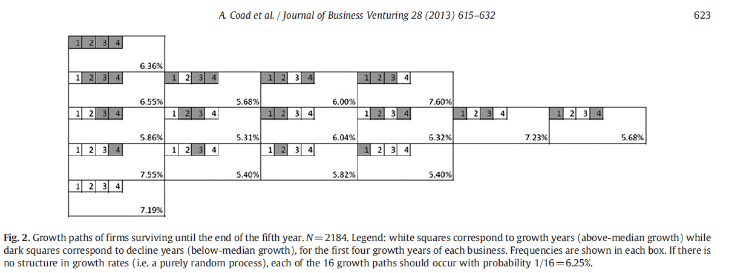
Growth paths?

Slide 24
Gibrat’s Law
An explanation of the lognormal firm size distribution (Gibrat, 1931)
Basic intuition – firm growth is random and independent of firm size
“The probability of a given proportionate change in size during a specified period is the same for all firms in a given industry – regardless of their size at the beginning of the period” Mansfield 1962 p1030

Slide 25
Implications of Gibrat‘s Law
Size and growth are unrelated?
Variance constant with size (not verified)
Gaussian growth rates?
Independent firms?
Serial growth rate correlation?

Slide 26
Does Gibrat’s Law hold?
Sutton (1997 JEL) – negative dependence of growth on size as a “statistical regularity”.
Caves (1998 JEL) – concludes his survey of industrial dynamics with the “substantive conclusion” that Gibrat‘s Law holds for firms above a certain size threshold, whilst for smaller firms growth rates decrease with size.
"Gibrat's Law holds, if at all, only for large firms and, among the smaller firms, a clear negative relationship between size and growth exists“ You (1995 CJE) p454

Slide 27
Determinants of growth rates
Size (“Gibrat’s Law”)
  smaller firms generally grow faster
Age
  younger firms generally grow faster
Growth rate autocorrelation
Innovation
  hard to find a link, but innovation more important for fast-growth firms
Financial performance, relative productivity
  not much association
Desire to grow
  But even desire to grow is a poor predictor of actual growth
Multiplant firms, legal status, characteristics of proprietor (human capital, sex)
Threshold effects (increases in firing costs, evade taxes in developing countries)
Low growth if there’s the ‘shadow of death sneaking around the corner’
Macro conditions (small firms grow faster during booms, large firms grow more during recessions)

Slide 28
Age and growth
Young firms grow faster (Fizaine 1968, Evans 1987a,b)
Young firms have higher growth variance (Evans 1987)
“once we control for firm age there is no systematic relationship between firm size and growth.” (Haltiwanger-Jarmin-Miranda 2013 REStat)

Slide 29
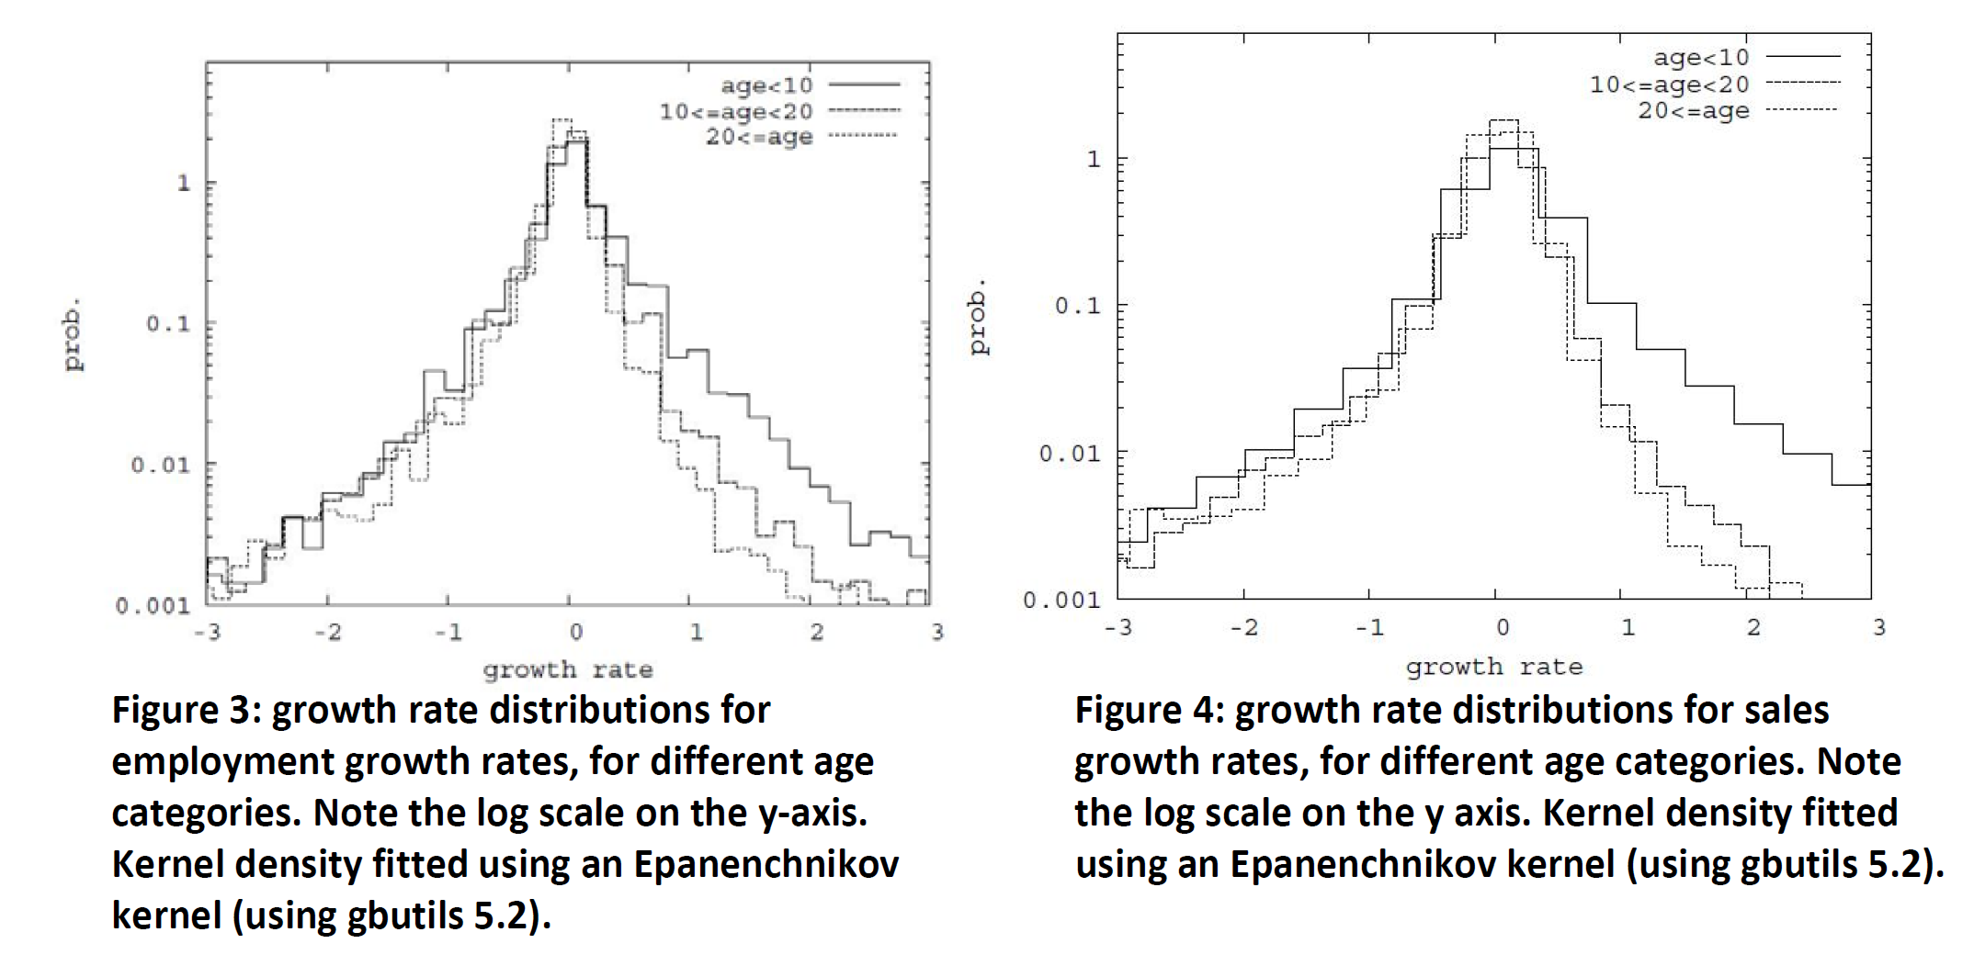
Age and growth
Coad Segarra Teruel 2013 SCED

Slide 30
Growth rate autocorrelation
Autocorrelation positive for large firms, negative for smaller firms
Fast-growth small firms have a particularly erratic growth profile
Large firms have a smoother growth profile

Slide 32
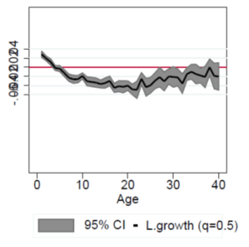
Autocorrelation by firm age
Coad-Daunfeldt-Halvarsson 2014
Positive autocorrelation for young firms
  Struggle to overcome the liability of newness and reach MES
Negative autocorrelation for old firms

Slide 33
Innovation and firm growth
Theoretical work and questionaires emphasize the role of innovation for growth
“Executives overwhelmingly say that innovation is what their companies need most for growth.”
McKinsey Global Survey of Business Executives (Carden, 2005:25).
Empirical work has had little success detecting the influence of innovation on firm growth

Slide 34
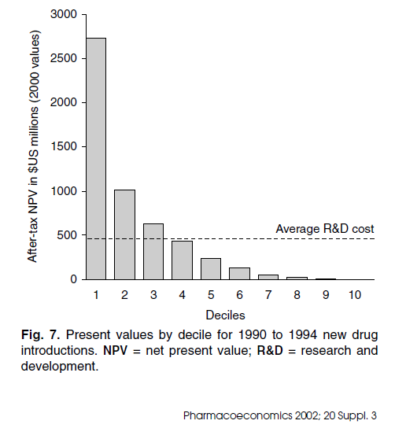
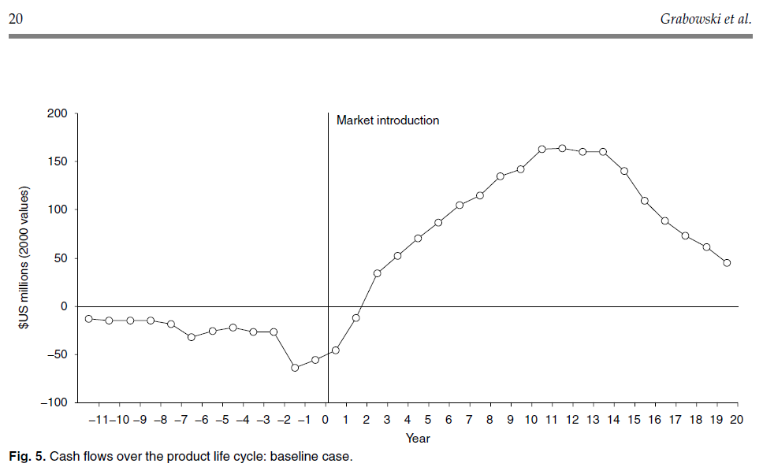
Innovation and firm growth
The returns to innovation are very skewed, with long payback times

Slide 35
Innovation and firm growth
The returns to innovation are very skewed, with long payback times
Firm growth rates – most firms hardly grow at all (close to zero), a handful of innovative firms experience fast growth

Slide 36
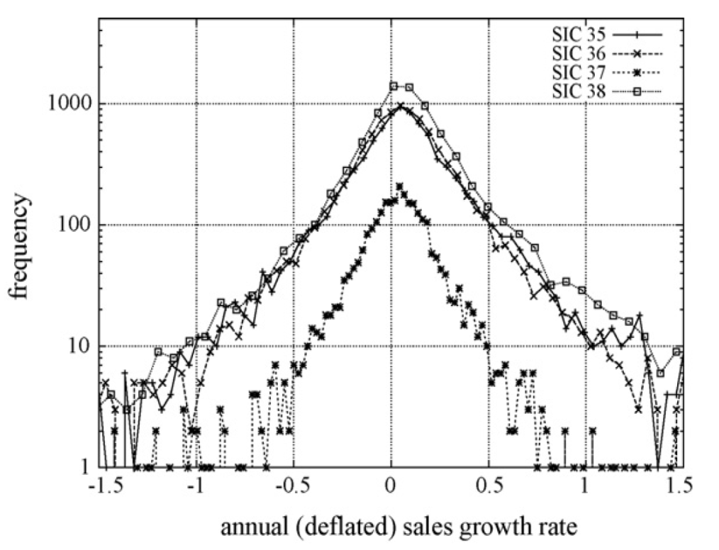
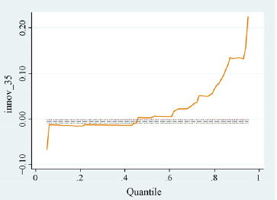
Quantile regression
Innovation and growth
Growth rate distribution
Coad Rao 2008 RP

Slide 37
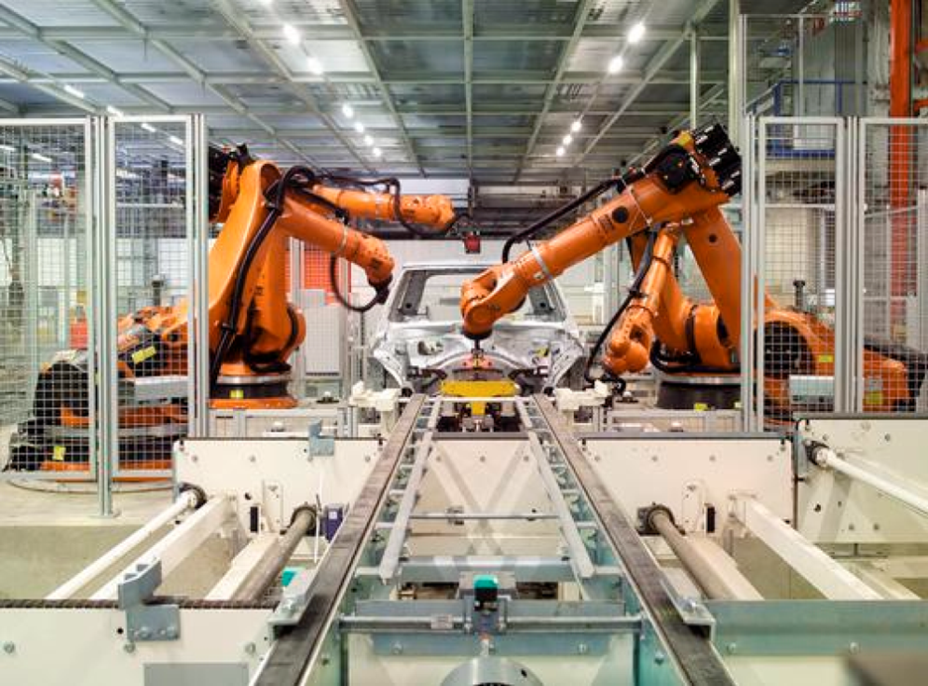
Innovation and employment growth
Are robots replacing humans?
If anything, innovation is usually associated with employment growth at the firm-level
Many substitution channels: (Spiezia & Vivarelli 2000, book chapter)
Compensation via new machines;
Compensation via decrease in prices;
Compensation via new investments;
Compensation via decrease in wages;
Compensation via increase in incomes;
Compensation via new products

Slide 38
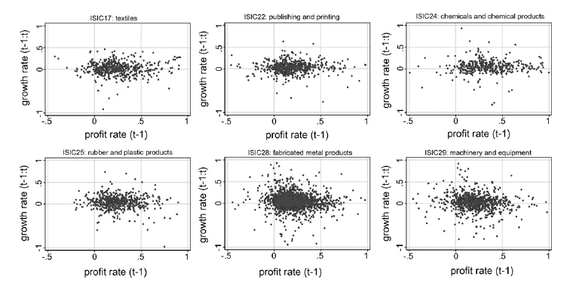
Financial performance and firm growth Coad 2007 SCED

Slide 39
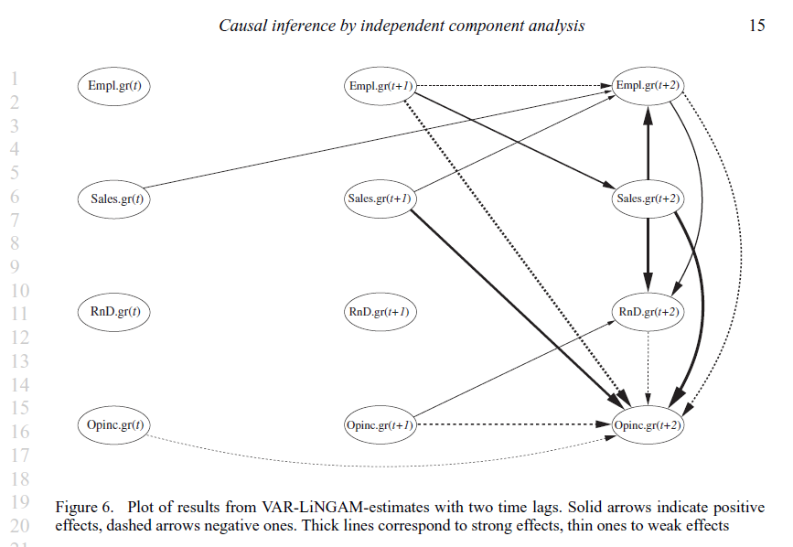
Moneta, Entner, Hoyer, Coad 2013 OBES

Slide 40
Characteristics of the founder
Human capital generally has a positive effect on growth
  Interaction of growth motivation & human capital a better predictor of growth (Wiklund and Shepherd 2003)
Males have faster growth
  Partly because of industry

Slide 41
Growth motivation
Wiklund and Shepherd (2003 JMS):
  Growth ambitions positively associated with growth
  The effect is magnified when interacted with education and business experience
Growth ambitions have a positive impact on growth, and growth encourages growth ambition: feedback effects (Delmar and Wiklund 2008 ET&P)
Stam and Wennberg (2009 SBE): growth ambition important for low-tech firms but not for the full sample

Slide 42
Threshold effects
Large firms try to avoid antitrust attention?
Increase in firing costs at around 8-15 employees in many countries
  15 in Italy (Schivardi and Torrini 2008)
  Effects on firm growth not too large

Slide 43
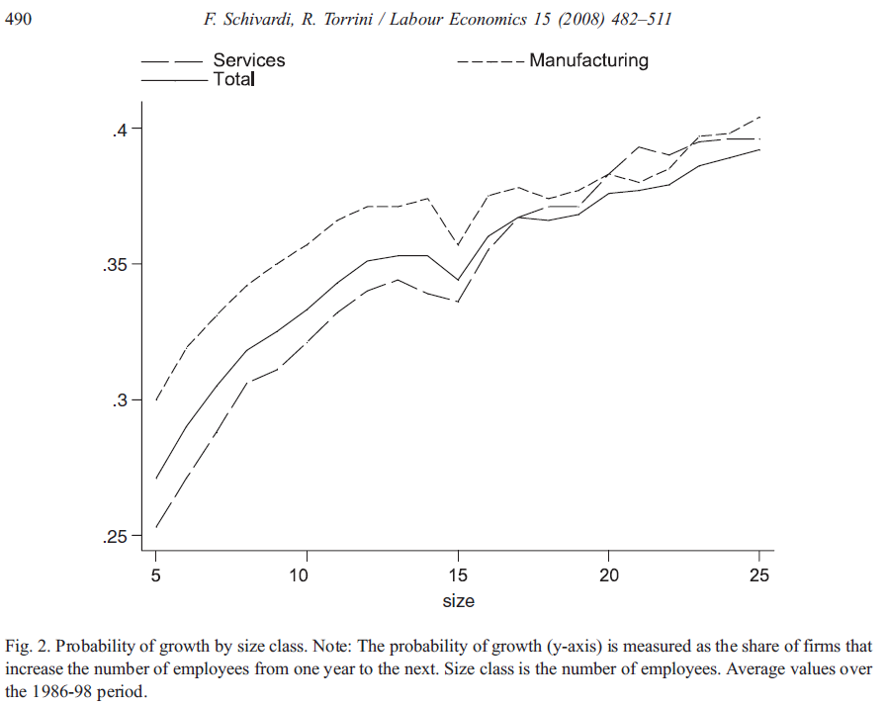

Slide 44
Rivalry and growth: Zero-sum game?
“competitors are typically seen as being in an ongoing, zero-sum battle with each other for customers, resources, and other rewards.”
Crane 2005 p234

Slide 45
Inter-firm ‘spillovers’
R&D spillovers | + | Knowledge flows from one firm to another | Drives costs down (process innovation); increases demand (product innovation) | Same industry or same region?
Productivity (Red Queen effects) | + | Interacting aspiration levels | Drives costs down | Same industry (global)
Passive sector trends | + | Exogenous changes in demand | Pushes demand up | Same industry, perhaps same country
Active sector trends | + | Advertising, | Pushes demand up | Same industry, perhaps same country
Rivalry in markets (Factor market rivalry (e.g. employees, key inputs),Rivalry in end markets (customer bases, market share)) | - | Competing for limited resources: employees, geographically-limited customer bases, etc | Increases costs (competition for inputs) or decreases demand (competition for sales) | Same country, same region, same industry

Slide 46
Rivalry: Empirical literature
Competition often measured as a vague, industry-wide force (concentration, rents, import penetration)
Questionnaire responses on perceived competition

Slide 47
Rivalry: Empirical literature
Storey (1994, pp. 144, 152): a survey of 4 empirical papers
  none of these four papers can find any statistically significant impact of competition on firm growth.
Geroski and Gugler (2004) – growth of rival firms
  Database on several thousand of the largest firms in 14 European countries.
  Main regression results: unable to detect any significant effect of rival's growth on firm growth – but a significant negative effect in specific industries i.e. differentiated good industries and advertising intensive industries

Slide 48
Rivalry: Empirical literature
Significant competition in specific narrowly-defined industries:
  Airlines (Goolsbee and Syverson 2008)
  Expiring patents and pharma firms (Bergman and Rudholm 2003)
  Other cases: dutch daily newspapers, competing supermarkets in specific cities, chocolate & praline markets, hamburger restaurants in shopping malls, NJ school bus route auctions…

Slide 49
Rivalry: Empirical literature
Questionnaire evidence:
  Hay and Kamshad 1994: intensity of competition is ranked as the most important constraint, by far, to the growth of small and medium sized firms in the UK
  Robson and Obeng (2008) report that 49.3% of entrepreneurs report “too many competing firms” as an important, or crucial limitation to these firms in achieving their objectives

Slide 50
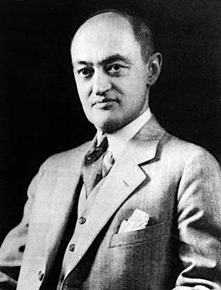
“The businessman feels himself to be in a competitive situation even if he is alone in his field or if, though not alone, he holds a position such that investigating government experts fail to see any effective competition between him and any other firms in the same or a neighboring field and in consequence conclude that his talk, under examination, about his competitive sorrows is all make-believe.”
(Schumpeter, 1950)

Slide 51
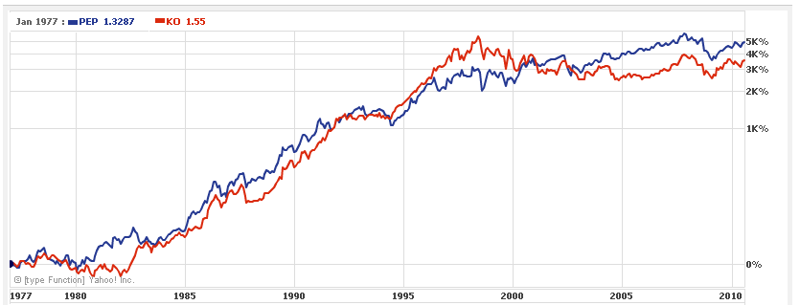
“Cut-throat” competition?
Preliminary speculation
http://finance.yahoo.com/echarts?s=PEP#chart2:symbol=pep;range=my;compare=ko;indicator=volume;charttype=line;crosshair=on;ohlcvalues=0;logscale=on;source=undefined

Slide 52
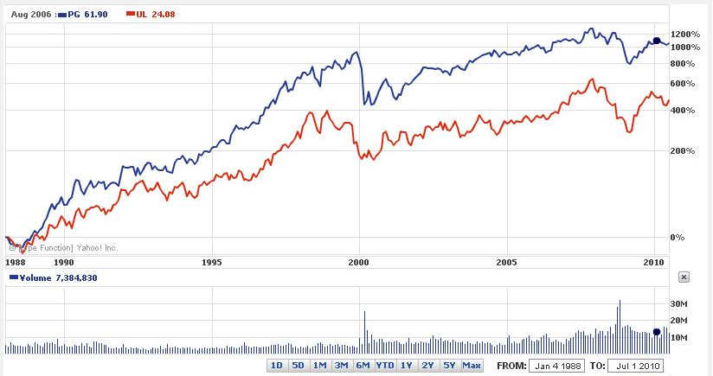


“Cut-throat” competition?
Preliminary speculation

Slide 53
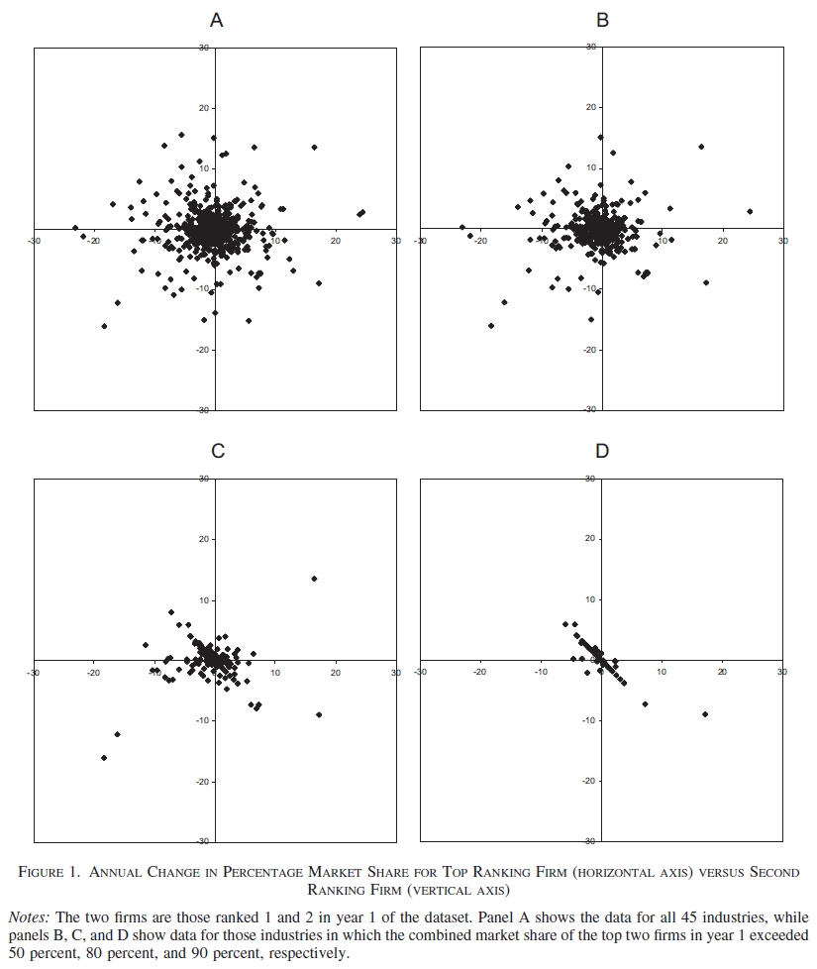
Sutton (2007) AER

Slide 54
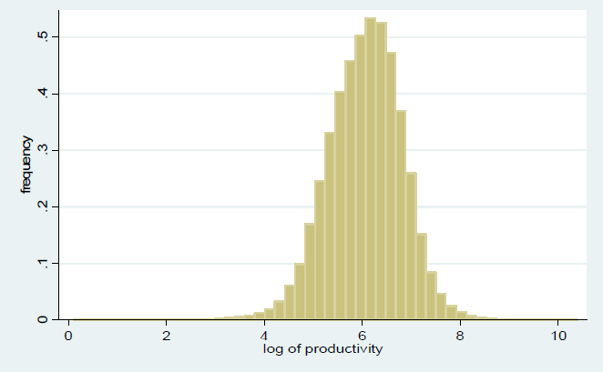
Ideally, who should grow?
(cf Productivity distribution: Okubo-Tomiura 2010 WP)
Productive firms ‘deserve’ to grow
Inefficient firms should first try to improve productivity

Slide 55
Ideally, who should grow?
High productivity firms should be encouraged to grow
Low productivity firms should first improve productivity before trying to grow
  Economic growth requires BOTH firm growth (job creation) and productivity growth (wealth creation)

Slide 56
Growth strategies
Replication – more of the same?
  Replication requires a template (Sid Winter)
  Tacit knowledge complicates replication
    Tacit knowledge vs explicit, codified knowledge
  Intel’s ‘copy EXACTLY!’ policy (MacDonald, 1998, ITR)
Diversification (related and unrelated)
  Synergies of technology or managerial competence
Exporting as the ‘highest synergy move’ (Ansoff 1987)
Organic growth vs Acquisitions
Franchising, alliances (licensing, joint ventures)

Slide 57
Stages of growth models
About 3-6 stages in roughly sequential ordering
Problems, strategies and priorities that firms are likely to face
Resolution of one set of problems brings on a period of steady growth but also new problems
Greiner 1998 HBR…

Slide 58
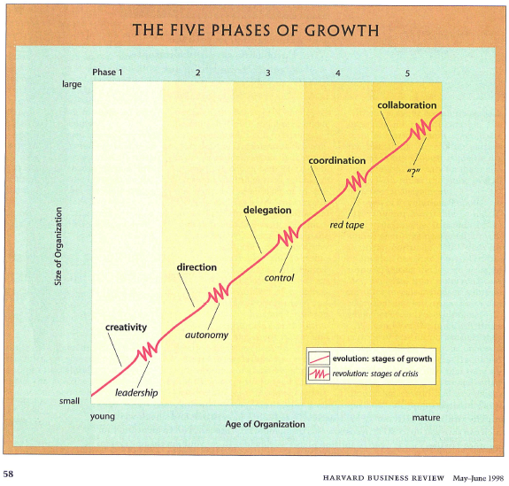

Slide 59
Stages of growth models
‘Common sense views of youth, adolescence, maturity and old age’ (Whetten 1987)
Dissatisfaction with stage models
  Too deterministic
  Too simple
  Little predictive power
  Change is continuous rather than episodic
Firms may struggle with the same recurring challenges, or face many at the same time
  ‘Processes’ rather than ‘stages’
My view: interesting idea if you don’t take it too literally, opens up thought on organizational transformations…

Slide 60
Advantages of growth
“Work is more fun in a growing company” (Roberts 2004)
Employees – promotion possibilities
Reach efficient scale
Growth often associated with a subsequent rise in profits

Slide 61
Disadvantages of growth
Loss of control
Risk aversion - growth and diversification can be daunting
Lifestyle firms in the comfort zone (managers close to retirement)
Restrict sales to avoid spoiling the market

Slide 62
Summary
Lots of small firms, very few grow to be large
Growth takes place in jumps and spurts, steady growth is not the norm
A small number of firms create most of the jobs…
… but it is very hard to predict which firms will grow
Firms can choose between several growth modes: replication, diversification, exporting, franchising, acquisition, alliances
Growth has profound changes on organizational structure
Not everyone wants to grow – there are pros and cons

Slide 63
Determinants of firm growth: a broader view
“The most elementary ‘fact’ about corporate growth thrown up by econometric work on both large and small firms is that firm size follows a random walk”
Geroski 2000 p169

Slide 64
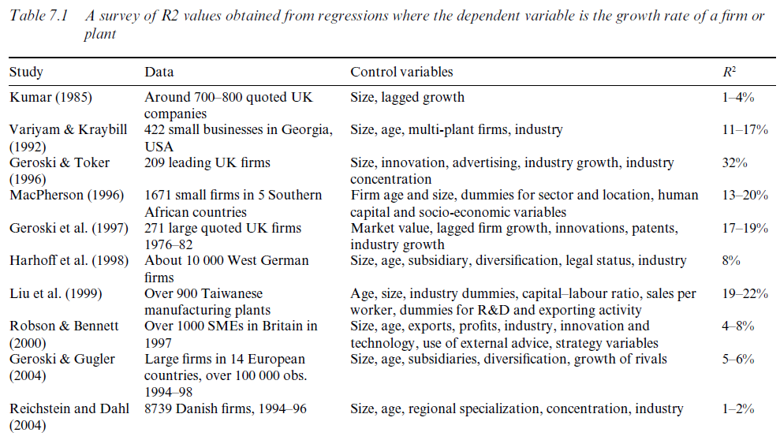
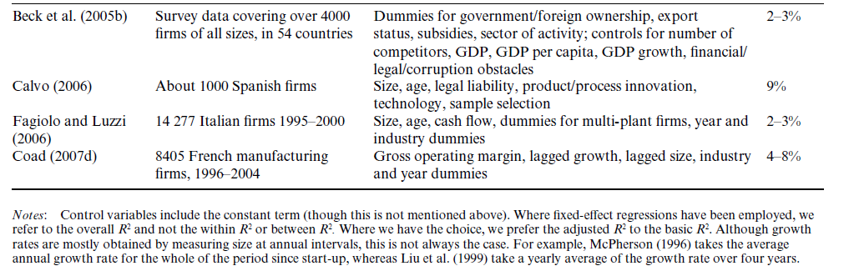

Slide 65
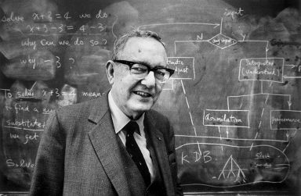
H A Simon, 1984, JEBO, p40
"In the physical sciences, when errors of measurement and other noise are found to be of the same order of magnitude as the phenomena under study, the response is not to try to squeeze more information out of the data by statistical means; it is instead to find techniques for observing the phenomena at a higher level of resolution.“
  Progress in firm growth research requires focusing on narrowly-defined subsamples?

Slide 66
Policy implications
Difficult to identify growth firms ex ante
  Best way of predicting which firm will have >£1m sales after 5 years is … if it has >£1m sales in year 1
Dubious effectiveness of ‘picking winners’
  Evaluate policy interventions wrt a counterfactual
    Would there be HGFs without HGF policy?
  More effective to combine govt funds with private funds
    R&D subsidies have been effective when govt subsidies combined with a firm’s own R&D

Slide 67
Effective policy support for firm growth
Focus on growth trigger points?
  Indivisibilities of firm growth
    Taking on a first employee (doubling of size)
    Opening a new plant
    Assist entry into export markets (Mason and Brown 2010)

Slide 68
Firm growth – recent results and challenges ahead
RECENT RESULTS:
Industry structure – distributions of growth rates, age distribution
Size and growth (Gibrat’s law), age and growth
Growth rate autocorrelation
Innovation and growth
Firm growth processes, growth paths
PUZZLING CHALLENGES AHEAD
Selection: Financial performance and growth
Selection: Competition
Coevolutionary processes & SVARs
Role of growth motivation

Slide 69
Perspectives for future research
Focus on specific subsamples?
  Lockett-Wiklund-Davidsson-Girma 2010 JMS: separating positive and negative growth firms, distinguishing between modes of growth (M&A & organic growth)
Managerial growth ambitions – an interesting variable, but there are limits to how much this explains (Stam Wennberg 2009 SBE, Wiklund-Patzelt-Shepherd 2009 SBE, Casillas Moreno 2010)
Need for variables that change within firms over time

